Slide 1
Splash Screen

Slide 2
Then/Now
You found the inverse of a function. (Lesson 7–2)
Evaluate logarithmic expressions.
Graph logarithmic functions.

Slide 3
Vocabulary
logarithm
logarithmic function

Slide 4
Concept

Slide 5
Example 1
Logarithmic to Exponential Form
A. Write log₃ 9 = 2 in exponential form.
log₃ 9 = 2 → 9 = 3²
Answer: 9 = 3²

Slide 6
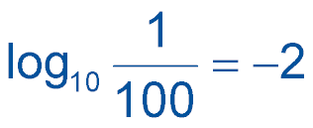
Example 1
Logarithmic to Exponential Form
B. Write in exponential form.
Answer:

Slide 7
Example 1
A. What is log₂ 8 = 3 written in exponential form?
A. 8³ = 2
B. 2³ = 8
C. 3² = 8
D. 2⁸ = 3
A
B
C
D

Slide 8
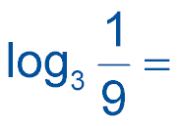
Example 1
B. What is –2 written in exponential form?
A.
B.
C.
D.
A
B
C
D

Slide 9
Example 2
Exponential to Logarithmic Form
A. Write 5³ = 125 in logarithmic form.
5³ = 125 → log₅ 125 = 3
Answer: log₅ 125 = 3

Slide 10
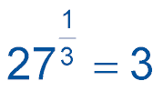
Example 2
Exponential to Logarithmic Form
B. Write in logarithmic form.
Answer:

Slide 11
Example 2
A. What is 3⁴ = 81 written in logarithmic form?
A. log₃ 81 = 4
B. log₄ 81 = 3
C. log₈₁ 3 = 4
D. log₃ 4 = 81
A
B
C
D

Slide 12
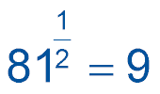
Example 2
B. What is written in logarithmic form?
A.
B.
C.
D.
A
B
C
D

Slide 13
Example 3
Evaluate Logarithmic Expressions
Evaluate log₃ 243.
log₃ 243 = y Let the logarithm equal y.
243 = 3^{y} Definition of logarithm
3⁵ = 3^{y} 243 = 3⁵
5 = y Property of Equality for Exponential Functions
Answer: So, log₃ 243 = 5.

Slide 14
Example 3
Evaluate log₁₀ 1000.
A.
B. 3
C. 30
D. 10,000
A
B
C
D

Slide 15
Concept

Slide 16
Example 4
Graph Logarithmic Functions
A. Graph the function f(x) = log₃ x.
Step 1 Identify the base.
b = 3
Step 2 Determine points on the graph.
Because 3 > 1, use the points (1, 0), and (b, 1).
Step 3 Plot the points and sketch the graph.

Slide 17
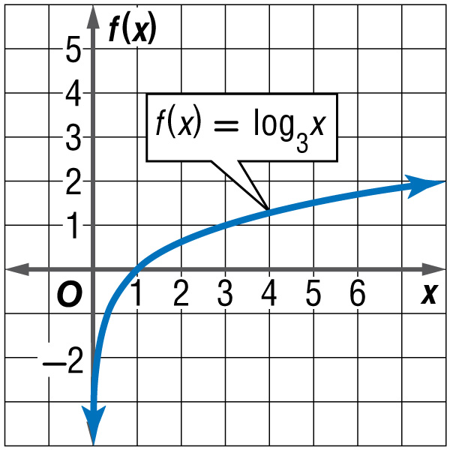
Example 4
Graph Logarithmic Functions
(1, 0)
(b, 1) → (3, 1)
Answer:

Slide 18
Example 4
Graph Logarithmic Functions
B. Graph the function
Step 1 Identify the base.
Step 2 Determine points on the graph.

Slide 19
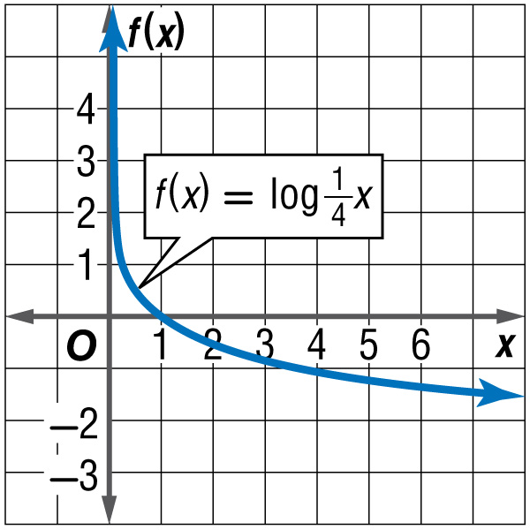
Example 4
Graph Logarithmic Functions
Step 3 Sketch the graph.
Answer:

Slide 20
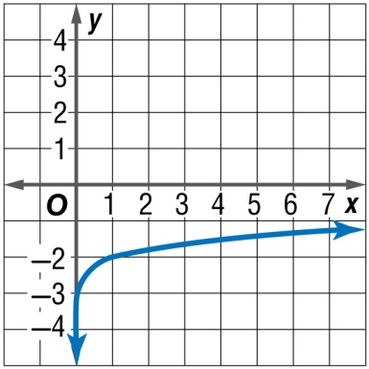
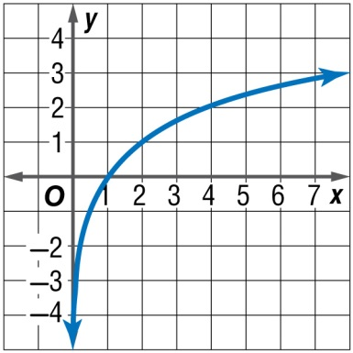
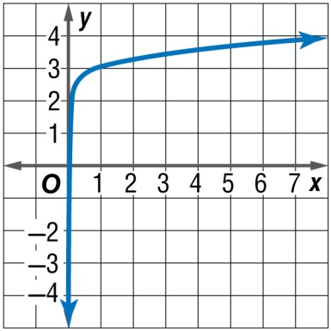
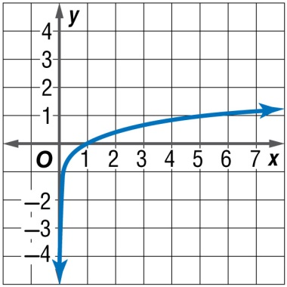
Example 4
A. Graph the function f(x) = log₅x.
A. B.
C. D.
A
B
C
D

Slide 21
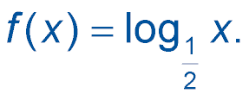
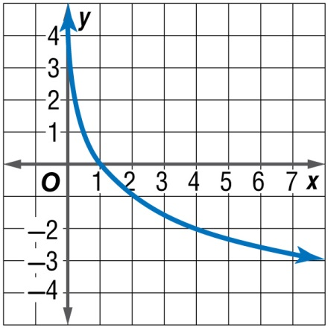
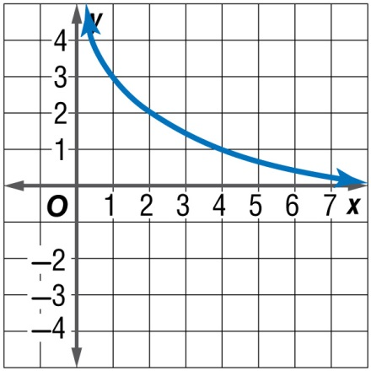
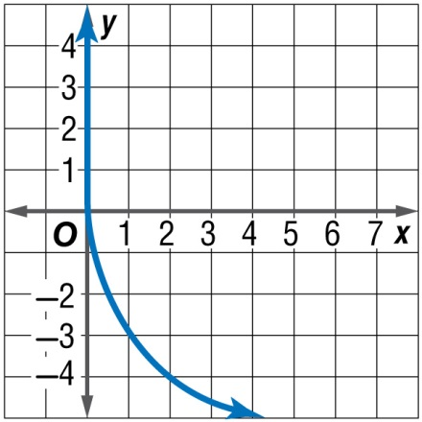
Example 4
B. Graph the function .
A. B.
C. D.
A
B
C
D

Slide 22
Concept

Slide 23
Example 5
Graph Logarithmic Functions
This represents a transformation of the graph f(x) = log₆ x.
● : The graph is compressed vertically.
● h = 0: There is no horizontal shift.
● k = –1: The graph is translated 1 unit down.

Slide 24
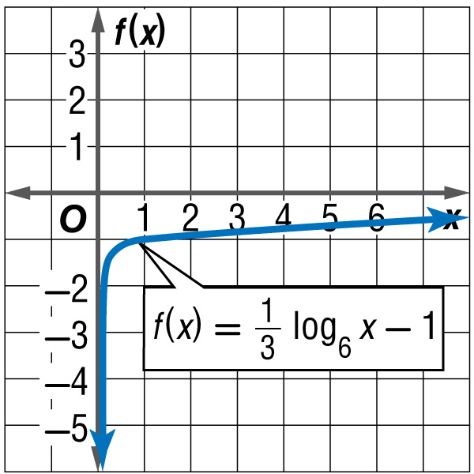
Example 5
Graph Logarithmic Functions
Answer:

Slide 25
Example 5
Graph Logarithmic Functions
● |a| = 4: The graph expands vertically.
● h = –2: The graph is translated 2 units to the left.
● k = 0: There is no vertical shift.

Slide 26
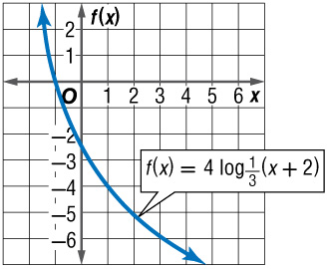
Example 5
Graph Logarithmic Functions
Answer:

Slide 27
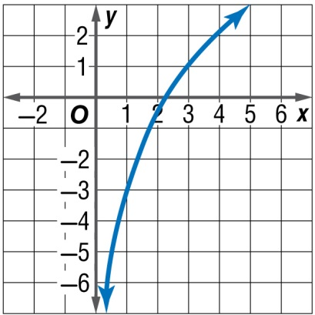
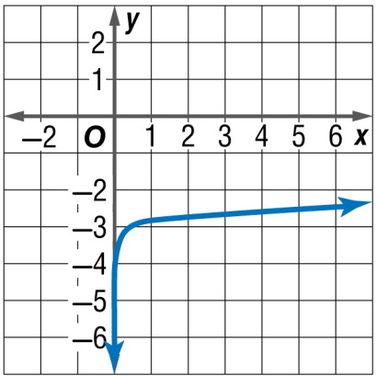
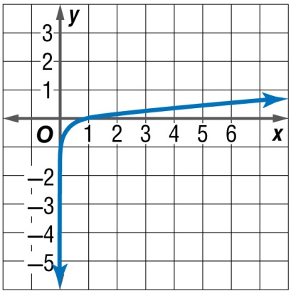
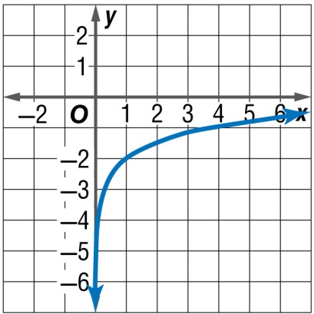
Example 5
A. B.
C. D.
A
B
C
D

Slide 28
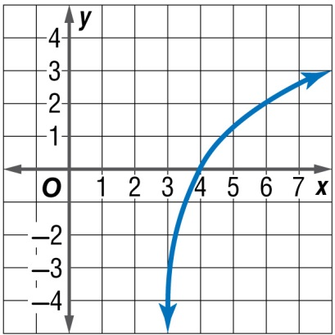
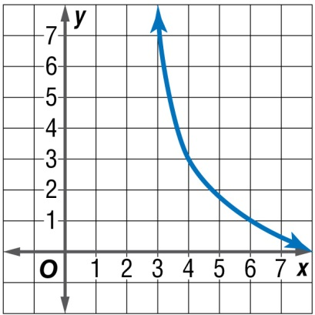
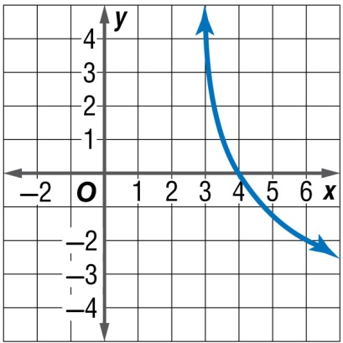
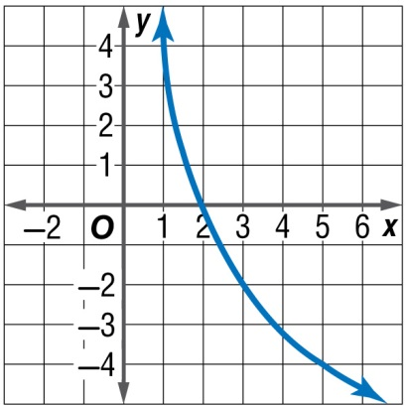
Example 5
A. B.
C. D.
A
B
C
D

Slide 29
Example 6
Find Inverses of Exponential Functions
A. AIR PRESSURE At Earth’s surface, the air pressure is defined as 1 atmosphere. Pressure decreases by about 20% for each mile of altitude. Atmospheric pressure can be modeled by P = 0.8^{x}, where x measures altitude in miles. Find the atmospheric pressure in atmospheres at an altitude of 8 miles.
P = 0.8^{x} Original equation
= 0.8⁸ Substitute 8 for x.
= 0.168 Use a calculator.
Answer: 0.168 atmosphere

Slide 30
Example 6
Find Inverses of Exponential Functions
B. AIR PRESSURE At Earth’s surface, the air pressure is defined as 1 atmosphere. Pressure decreases by about 20% for each mile of altitude. Atmospheric pressure can be modeled by P = 0.8^{x}, where x measures altitude in miles. Write an equation for the inverse of the function.
P = 0.8^{x} Original equation
x = 0.8^{P} Replace x with P, replace P with x, and solve for P.
P = log_{0.8} x Definition of logarithm
Answer: P = log_{0.8} x

Slide 31
Example 6
A. AIR PRESSURE The air pressure of a car tire is 44 lbs/in². The pressure decreases gradually by about 1% for each trip of 50 miles driven. The air pressure can be modeled by P = 44(0.99^{x}), where x measures the number of 50-mile trips. Find the air pressure in pounds per square inch after driving 350 miles.
A
B
C
D
A. 42
B. 41
C. 40
D. 39

Slide 32
Example 6
B. AIR PRESSURE The air pressure of a car tire is 44 lbs/in². The pressure decreases gradually by about 1% for each trip of 50 miles driven. The air pressure can be modeled by P = 44(0.99^{x}), where x measures the number of 50-mile trips. Write an equation for the inverse of the function.
A. P = 44 log_{0.99} x
B. P = log_{0.99} x
C.
D.
A
B
C
D

Slide 33
End of the Lesson

