Slide 1
Splash Screen

Slide 2
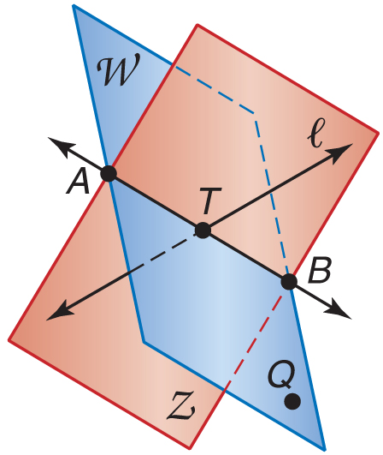
5-Minute Check 1
Name three collinear points.
A. A, B, Q
B. B, Q, T
C. A, B, T
D. T, A, Q
A
B
C
D

Slide 3
5-Minute Check 2
What is another name for AB?
A. AA
B. AT
C. BQ
D. QB
A
B
C
D

Slide 4
5-Minute Check 3
Name a line in plane Z.
A. AT
B. AW
C. AQ
D. BQ
A
B
C
D

Slide 5
5-Minute Check 4
Name the intersection of planes Z and W.
A. BZ
B. AW
C. AB
D. BQ
A
B
C
D

Slide 6
5-Minute Check 5
How many lines are in plane Z?
A. 2
B. 4
C. 6
D. infinitely many
A
B
C
D

Slide 7
5-Minute Check 6
Which of the following statements is always false?
A. The intersection of a line and a plane is a point.
B. There is only one plane perpendicular to a given plane.
C. Collinear points are also coplanar.
D. A plane contains an infinite number of points.
A
B
C
D

Slide 8
Then/Now
You identified and modeled points, lines, and planes. (Lesson 1–1)
Measure segments.
Calculate with measures.

Slide 9
Vocabulary
line segment
betweenness of points
between
congruent segments
construction

Slide 10
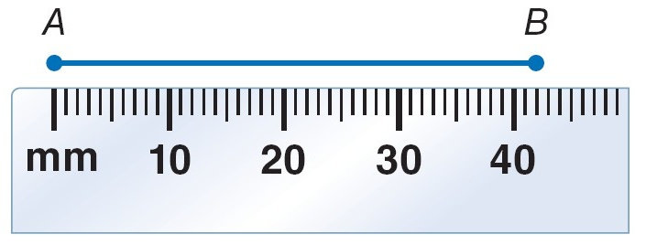
Example 1
Length in Metric Units
A. Find the length of AB using the ruler.
The ruler is marked in millimeters.
Point B is closer to the 42 mm mark.
Answer: AB is about 42 millimeters long.

Slide 11
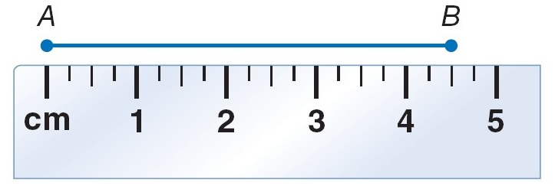
Example 1
Length in Metric Units
B. Find the length of AB using the ruler.
Each centimeter is divided into fourths.
Point B is closer to the 4.5 cm mark.
Answer: AB is about 4.5 centimeters long.

Slide 12
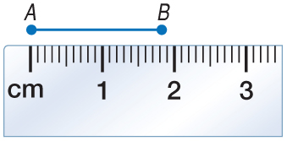
Example 1a
A
B
C
D
A. 2 mm
B. 1.8 mm
C. 18 mm
D. 20 mm

Slide 13
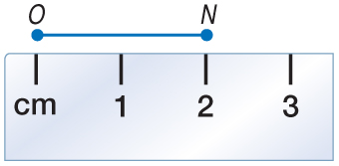
Example 1b
B.
A
B
C
D
A. 1 cm
B. 2 cm
C. 2.5 cm
D. 3 cm

Slide 14
Example 2
Length in Standard Units
A.
Each inch is divided into sixteenths. Point E is closer to the 3-inch mark.

Slide 15
Example 2
Length in Standard Units
B.

Slide 16
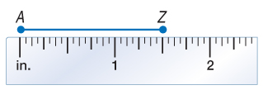
Example 2a
A.
A.
B.
C.
D.
A
B
C
D

Slide 17
Example 2a
B.
A.
B.
C.
D.
A
B
C
D

Slide 18
Concept

Slide 19
Example 3
Find Measurements by Adding
Find XZ. Assume that the figure is not drawn to scale.
___
XZ is the measure of XZ. Point Y is between X and Z. XZ can be found by adding XY and YZ.

Slide 20
Example 3
Find Measurements by Adding
Add.

Slide 21
Example 3
Find BD. Assume that the figure is not drawn to scale.
D
50.4 mm
A. 16.8 mm
B. 57.4 mm
C. 67.2 mm
D. 84 mm
16.8 mm
C
A
B
C
D
B

Slide 22
Example 4
Find Measurements by Subtracting
Find LM. Assume that the figure is not drawn to scale.
Point M is between L and N.
LM + MN = LN Betweenness of points
LM + 2.6 = 4 Substitution
LM + 2.6 – 2.6 = 4 – 2.6 Subtract 2.6 from each side.
LM = 1.4 Simplify.

Slide 23
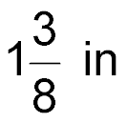
Example 4
Find TU. Assume that the figure is not drawn to scale.
3 in
V
in.
A.
B.
C.
D.
U
T
in.
A
B
C
D
in.
in.

Slide 24
Example 5
Write and Solve Equations to Find Measurements
ALGEBRA Find the value of x and ST if T is between S and U, ST = 7x, SU = 45, and TU = 5x – 3.
Draw a figure to represent this situation.
ST + TU = SU Betweenness of points
7x + 5x – 3 = 45 Substitute known values.
7x + 5x – 3 + 3 = 45 + 3 Add 3 to each side.
12x = 48 Simplify.

Slide 25
Example 5
Write and Solve Equations to Find Measurements
x = 4 Simplify.
Now find ST.
ST = 7x Given
= 7(4) x = 4
= 28 Multiply.
Answer: x = 4, ST = 28

Slide 26
Example 5
ALGEBRA Find the value of n and WX if W is between X and Y, WX = 6n – 10, XY = 17, and WY = 3n.
A. n = 3; WX = 8
B. n = 3; WX = 9
C. n = 9; WX = 27
D. n = 9; WX = 44
A
B
C
D

Slide 27
Concept

Slide 28
Example 6
Congruent Segments
FONTS The Arial font is often used because it is easy to read. Study the word time shown in Arial type. Each letter can be broken into individual segments. The letter T has two segments, a short horizontal segment, and a longer vertical segment. Assume that all segments overlap where they meet. Which segments are congruent?
TIME
Answer: The five vertical segments in the letters T, I, M, and E are congruent. The four horizontal segments in T and E are congruent. The two diagonal segments in the letter M are congruent.

Slide 29
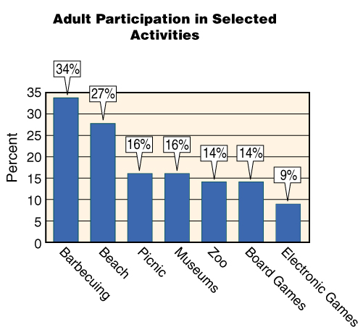
Example 6
LEISURE ACTIVITIES The graph shows the percent of adults who participated in selected activities. Suppose a segment was drawn along the height of each bar. Which categories would have segments that are congruent?
A
B
C
D
A. barbecuing and beach
B. board games and museums
C. beach and picnic
D. zoo and board games

Slide 30
End of the Lesson

