Slide 1
Splash Screen

Slide 2
Then/Now
You measured one-dimensional figures. (Lesson 1–2)
Identify and name polygons.
Find perimeter, circumference, and area of two-dimensional figures.

Slide 3
Vocabulary
equiangular polygon
regular polygon
perimeter
circumference
area
polygon
vertex of a polygon
concave
convex
n-gon
equilateral polygon

Slide 4
Concept

Slide 5
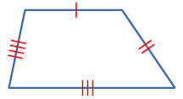
Example 1
Name and Classify Polygons
A. Name the polygon by its number of sides. Then classify it as convex or concave and regular or irregular.
There are 4 sides, so this is a quadrilateral.
No line containing any of the sides will pass through the interior of the quadrilateral, so it is convex.
The sides are not congruent, so it is irregular.
Answer: quadrilateral, convex, irregular

Slide 6
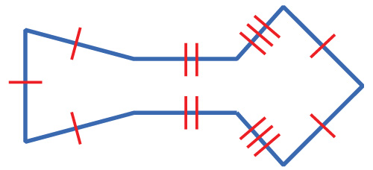
Example 1
Name and Classify Polygons
B. Name the polygon by its number of sides. Then classify it as convex or concave and regular or irregular.
There are 9 sides, so this is a nonagon.
Lines containing some of the sides will pass through the interior of the nonagon, so it is concave.
Since the polygon is concave, it must be irregular.
Answer: nonagon, concave, irregular

Slide 7
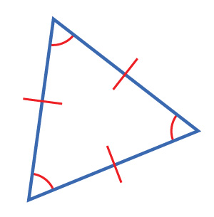
Example 1a
A. Name the polygon by the number of sides. Then classify it as convex or concave and regular or irregular.
A. triangle, concave, regular
B. triangle, convex, irregular
C. quadrilateral, convex, regular
D. triangle, convex, regular
A
B
C
D

Slide 8
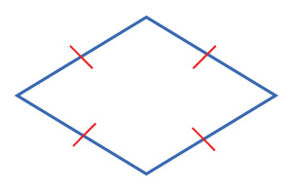
Example 1b
B. Name the polygon by the number of sides. Then classify it as convex or concave and regular or irregular.
A. quadrilateral, convex, irregular
B. pentagon, convex, irregular
C. quadrilateral, convex, regular
D. quadrilateral, concave, irregular
A
B
C
D

Slide 9
Concept

Slide 10
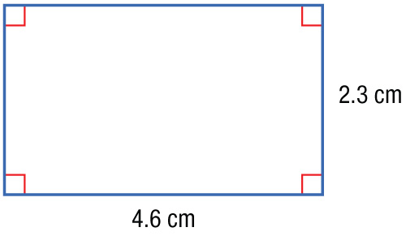
Example 2
Find Perimeter and Area
A. Find the perimeter and area of the figure.
P = 2ℓ + 2w Perimeter of a rectangle
= 2(4.6) + 2(2.3) ℓ = 4.6, w = 2.3
= 13.8 Simplify.
Answer: The perimeter of the rectangle is 13.8 cm.

Slide 11
Example 2
Find Perimeter and Area
A. Find the perimeter and area of the figure.
A = ℓw Area of a rectangle
= (4.6)(2.3) ℓ = 4.6, w = 2.3
= 10.58 Simplify.
Answer: The area of the rectangle is about 10.6 cm².

Slide 12
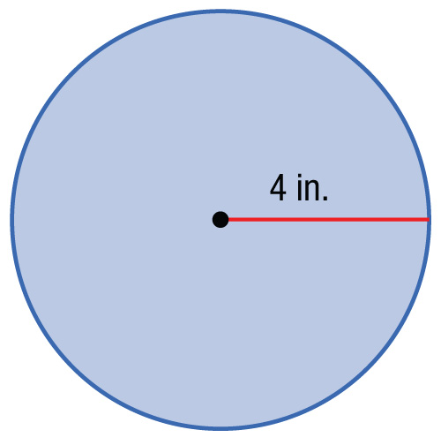
Example 2
Find Perimeter and Area
B. Find the circumference and area of the figure.
≈ 25.1 Use a calculator.
Answer: The circumference of the circle is about 25.1 inches.

Slide 13
Example 2
Find Perimeter and Area
B. Find the circumference and area of the figure.
≈ 50.3 Use a calculator.
Answer: The area of the circle is about 50.3 square inches.

Slide 14
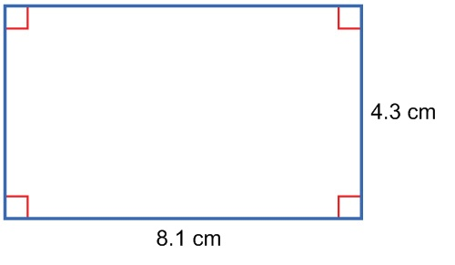
Example 2a
A. Find the perimeter and area of the figure.
A. P = 12.4 cm, A = 24.8 cm²
B. P = 24.8 cm, A = 34.83 cm²
C. P = 34.83 cm, A = 69.66 cm²
D. P = 24.4 cm, A = 32.3 cm²
A
B
C
D

Slide 15
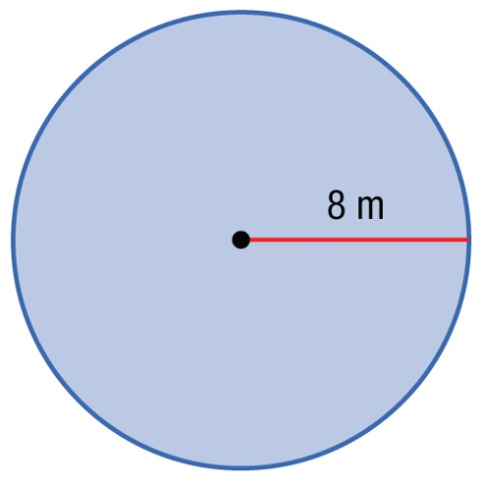
Example 2b
B. Find the circumference and area of the figure.
A. C ≈ 25.1 m, A ≈ 50.3 m²
B. C ≈ 25.1 m, A ≈ 201.1 m²
C. C ≈ 50.3 m, A ≈ 201.1 m²
D. C ≈ 201.1 m, A ≈ 402.1 m²
A
B
C
D

Slide 16
Example 3
Terri has 19 feet of tape to mark an area in the classroom where the students may read. Which of these shapes has a perimeter or circumference that would use most or all of the tape?
A square with side length of 5 feet
B circle with the radius of 3 feet
C right triangle with each leg length of 6 feet
D rectangle with a length of 8 feet and a width of 3 feet
Read the Test Item
You are asked to compare the perimeters or circumference of four different shapes.

Slide 17
Example 3
Solve the Test Item
Find each perimeter or circumference.
Square
P = 4s Perimeter of a square
= 4(5) s = 5
= 20 feet Simplify.
Circle
C = 2πr Circumference
= 2π(3) r = 3
= 6π Simplify.
≈ 18.85 feet Use a calculator.

Slide 18
Example 3
Right Triangle
Use the Pythagorean Theorem to find the length of the hypotenuse.
c² = a² + b² Pythagorean Theorem
= 6² + 6² a = 6, b = 6
= 72 Simplify.
.
≈ 8.49 Use a calculator.
P = a + b + c Perimeter of a triangle
≈ 6 + 6 + 8.49 Substitution
≈ 20.49 feet Simplify.

Slide 19
Example 3
Rectangle
P = 2ℓ + 2w Perimeter of a rectangle
= 2(8) + 2(3) ℓ = 8, w = 3
= 22 feet Simplify.
The only shape for which Terri has enough tape is the circle.
Answer: The correct answer is B.

Slide 20
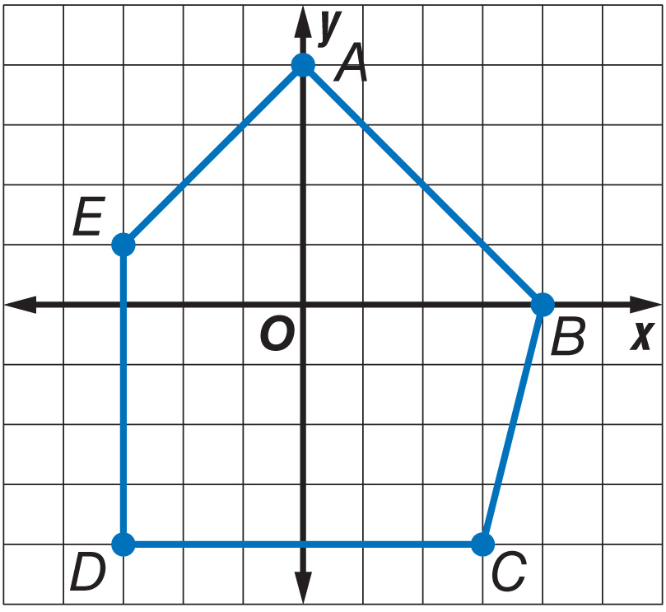
Example 4
Perimeter and Area on the Coordinate Plane
Find the perimeter and area of a pentagon ABCDE with A(0, 4), B(4, 0), C(3, –4), D(–3, –4), and E(–3, 1).

Slide 21
Example 4
Perimeter and Area on the Coordinate Plane
Step 1
By counting squares on the grid, we find that CD = 6 units and DE = 5 units. Use the Distance Formula,
to find AB, BC, and EA.

Slide 22
Example 4
Perimeter and Area on the Coordinate Plane
The perimeter of pentagon ABCDE is 5.7 + 4.1 + 6 + 5 + 4.2 or about 25 units.

Slide 23
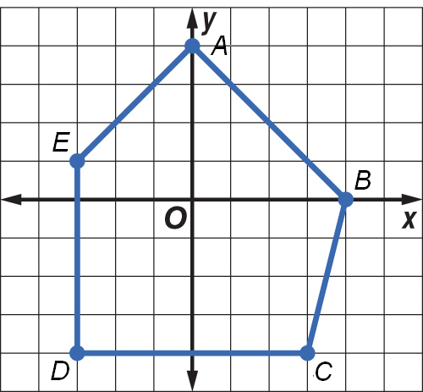
Example 4
Perimeter and Area on the Coordinate Plane
Step 2
Divide the pentagon into two triangles and a rectangle.
Find the area of the triangles.
Area of Triangle 1
Area of a triangle
Substitute.
Simplify.

Slide 24
Example 4
Perimeter and Area on the Coordinate Plane
Area of Triangle 2
Substitute.
Simplify.

Slide 25
Example 4
Perimeter and Area on the Coordinate Plane
Find the area of the rectangle.
Area of a rectangle
Substitute.
Simplify.
The area of pentagon ABCDE is 9 + 2.5 + 30 or 41.5 square units.
Answer: The perimeter is about 25 units and the area is 41.5 square units.

Slide 26
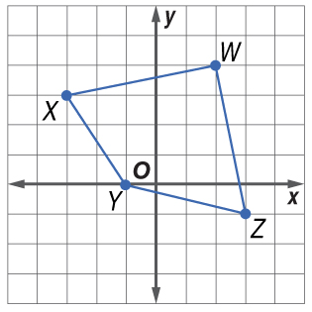
Example 4
Find the perimeter of quadrilateral WXYZ with W(2, 4), X(–3, 3), Y(–1, 0), and Z(3, –1).
A. 17.9
B. 22
C. 13.3
D. 9.1
A
B
C
D

Slide 27
End of the Lesson

