Slide 1
Geometry
Section 2-1
Inductive Reasoning

Slide 2
Then/Now
You used data to find patterns and make predictions.
Make conjectures based on inductive reasoning.
Find counterexamples.

Slide 3
Vocabulary
inductive reasoning
conjecture
counterexample

Slide 4
Example 1
Patterns and Conjecture
A. Write a conjecture that describes the pattern 2, 4, 12, 48, 240. Then use your conjecture to find the next item in the sequence.
Step 1 Look for a pattern.
2 4 12 48 240
×2
×3
×4
×5
Step 2 Make a conjecture
The numbers are multiplied by 2, 3, 4, and 5. The next number will be multiplied by 6. So, it will be 6 ● 240 or 1440.
Answer: 1440

Slide 5
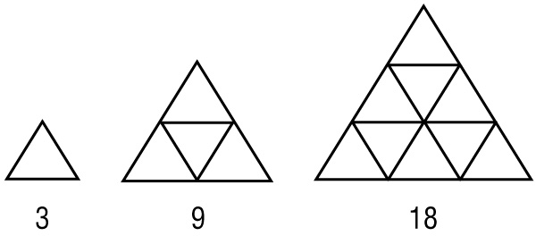
Example 1
Patterns and Conjecture
B. Write a conjecture that describes the pattern shown. Then use your conjecture to find the next item in the sequence.
Step 1 Look for a pattern.
3 9 18
+6
+9

Slide 6
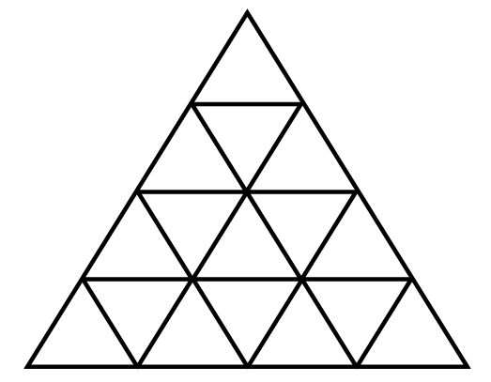
Example 1
Patterns and Conjecture
Step 2 Make a conjecture.
Conjecture: Notice that 6 is 3 × 2 and 9 is 3 × 3. The next figure will increase by 3 × 4 or 12 segments. So, the next figure will have 18 + 12 or 30 segments.
Answer: 30 segments
Check Draw the next figure to check your conjecture.

Slide 7
Example 1
A. Write a conjecture that describes the pattern in the sequence. Then use your conjecture to find the next item in the sequence.
A. B.
C. D.
A
B
C
D

Slide 8
Example 1
B. Write a conjecture that describes the pattern in the sequence. Then use your conjecture to find the next item in the sequence.
1
3
6
10
A. The next figure will have 10 circles.
B. The next figure will have 10 + 5 or 15 circles.
C. The next figure will have 15 + 5 or 20 circles.
D. The next figure will have 15 + 6 or 21 circles.
A
B
C
D

Slide 9
Example 2
Algebraic and Geometric Conjectures
A. Make a conjecture about the sum of an odd number and an even number. List some examples that support your conjecture.
Step 1 List some examples.
1 + 2 = 3 1 + 4 = 5 4 + 5 = 9 5 + 6 = 11
Step 2 Look for a pattern.
Notice that the sums 3, 5, 9, and 11 are all odd numbers.
Step 3 Make a conjecture.
Answer: The sum of an odd number and an even number is odd.

Slide 10
Example 2
Algebraic and Geometric Conjectures
B. For points L, M, and N, LM = 20, MN = 6, and LN = 14. Make a conjecture and draw a figure to illustrate your conjecture.
Step 1 Draw a figure.
Step 2 Examine the figure.
Since LN + MN = LM, the points can be collinear with point N between points L and M.
Step 3 Make a conjecture.
Answer: L, M, and N are collinear.

Slide 11
Example 2
A. Make a conjecture about the product of two odd numbers.
A. The product is odd.
B. The product is even.
C. The product is sometimes even, sometimes odd.
D. The product is a prime number.
A
B
C
D

Slide 12
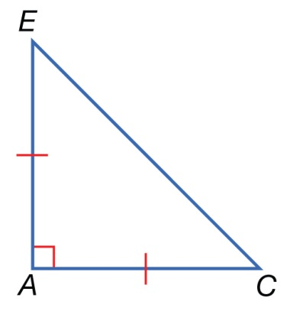
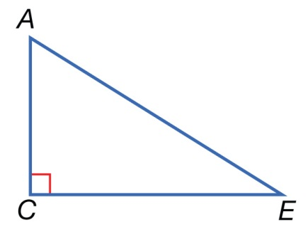
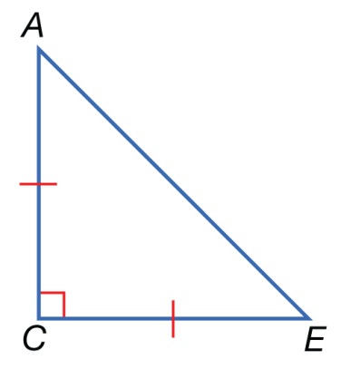
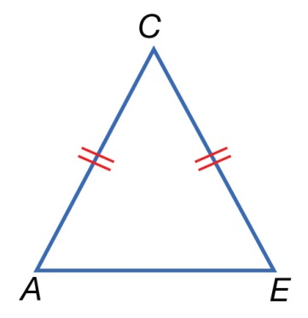
Example 2
B. Given: ACE is a right triangle with AC = CE. Which figure would illustrate the following conjecture? ΔACE is isosceles, ∠C is a right angle, and is the hypotenuse.
A. B.
C. D.
A
B
C
D

Slide 13
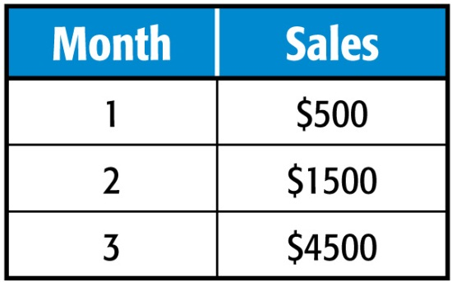
Example 3
Make Conjectures from Data
A. SALES The table shows the total sales for the first three months a store is open. The owner wants to predict the sales for the fourth month.
Make a statistical graph that best displays the data.
Since you want to look for a pattern over time, use a scatter plot to display the data. Label the horizontal axis with the months and the vertical axis with the amount of sales. Plot each set of data.

Slide 14
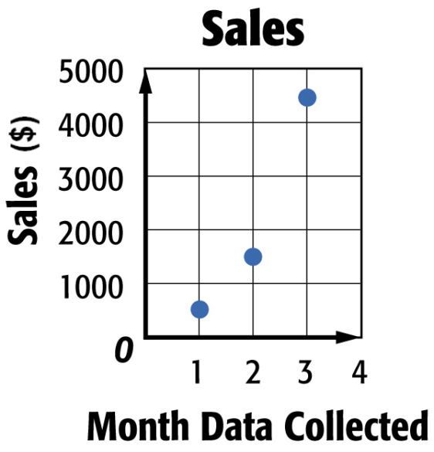
Example 3
Make Conjectures from Data
Answer:

Slide 15
Example 3
Make Conjectures from Data
B. SALES The table shows the total sales for the first three months a store is open. The owner wants to predict the sales for the fourth month.
Make a conjecture about the sales in the fourth month and justify your claim or prediction.
Look for patterns in the data. The sales triple each month.
Answer: The sales triple each month, so in the fourth month there will be $4500 × 3 or $13,500 in sales.

Slide 16
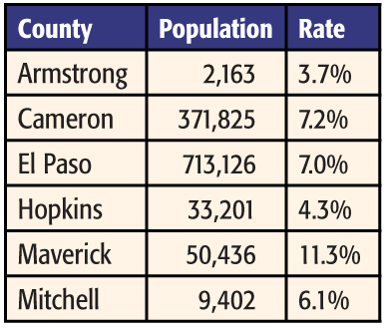
Example 4
Find Counterexamples
UNEMPLOYMENT Based on the table showing unemployment rates for various counties in Texas, find a counterexample for the following statement. The unemployment rate is highest in the cities with the most people.

Slide 17
Example 4
Find Counterexamples
Examine the data in the table. Find two cities such that the population of the first is greater than the population of the second, while the unemployment rate of the first is less than the unemployment rate of the second. El Paso has a greater population than Maverick, while El Paso has a lower unemployment rate than Maverick.
Answer: Maverick has only 50,436 people in its population, and it has a higher rate of unemployment than El Paso, which has 713,126 people in its population.

Slide 18
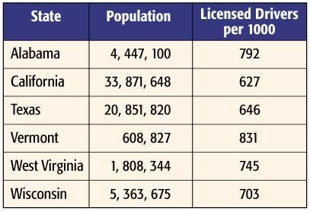
Example 4
DRIVING This table shows selected states, the 2000 population of each state, and the number of people per 1000 residents who are licensed drivers in each state. Based on the table, which two states could be used as a counterexample for the following statement? The greater the population of a state, the lower the number of drivers per 1000 residents.
A
B
C
D
A. Texas and California
B. Vermont and Texas
C. Wisconsin and West Virginia
D. Alabama and West Virginia

Slide 19
End of the Lesson

