Slide 1
Splash Screen

Slide 2
Then/Now
You found counterexamples for false conjectures. (Lesson 2–1)
Determine truth values of negations, conjunctions, and disjunctions, and represent them using Venn diagrams.
Find counterexamples.

Slide 3
Vocabulary
statement
truth value
negation
compound statement
conjunction
disjunction
truth table

Slide 4
Example 1
Truth Values of Conjunctions
A. Use the following statements to write a compound statement for the conjunction p and q. Then find its truth value. p: One foot is 14 inches. q: September has 30 days. r: A plane is defined by three noncollinear points.
Answer: p and q: One foot is 14 inches, and September has 30 days. Although q is true, p is false. So, the conjunction of p and q is false.

Slide 5
Example 1
Truth Values of Conjunctions
B. Use the following statements to write a compound statement for the conjunction ~p ∧ r. Then find its truth value. p: One foot is 14 inches. q: September has 30 days. r: A plane is defined by three noncollinear points.
Answer: ~p ∧ r: A foot is not 14 inches, and a plane is defined by three noncollinear points. ~p ∧ r is true, because ~p is true and r is true.

Slide 6
Example 2
Truth Values of Disjunctions
A. Use the following statements to write a compound statement for the disjunction p or q. Then find its truth value.
p: is proper notation for “segment AB.” q: Centimeters are metric units. r: 9 is a prime number.
Answer: is proper notation for “segment AB,” or centimeters are metric units. Both p and q are true, so p or q is true.

Slide 7
Example 2
Truth Values of Disjunctions
B. Use the following statements to write a compound statement for the disjunction q ∨ r. Then find its truth value.
p: is proper notation for “segment AB.” q: Centimeters are metric units. r: 9 is a prime number.
Answer: Centimeters are metric units, or 9 is a prime number. q ∨ r is true because q is true. It does not matter that r is false.

Slide 8
Example 2
Truth Values of Disjunctions
C. Use the following statements to write a compound statement for the disjunction ~p ∨ r. Then find its truth value.
p: is proper notation for “segment AB.” q: Centimeters are metric units. r: 9 is a prime number.
___
Answer: AB is not proper notation for “segment AB,” or 9 is a prime number. Since not p and r are both false, ~p ∨ r is false.

Slide 9
Concept

Slide 10
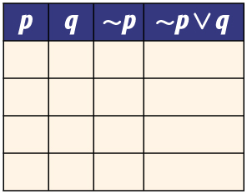
Example 3
Construct Truth Tables
A. Construct a truth table for ~p ∨ q.
Step 1 Make columns with the heading p, q, ~p, and ~p ∨ q.

Slide 11
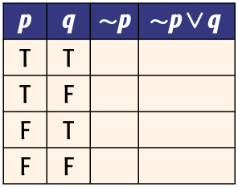
Example 3
Construct Truth Tables
A. Construct a truth table for ~p ∨ q.
Step 2 List the possible combinations of truth values for p and q.

Slide 12
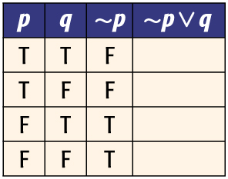
Example 3
Construct Truth Tables
A. Construct a truth table for ~p ∨ q.
Step 3 Use the truth values of p to determine the truth values of ~p.

Slide 13
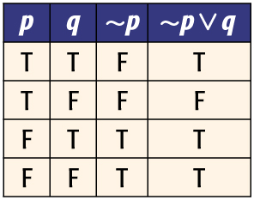
Example 3
Construct Truth Tables
A. Construct a truth table for ~p ∨ q.
Step 4 Use the truth values of ~p and q to write the truth values for ~p ∨ q.
Answer:

Slide 14
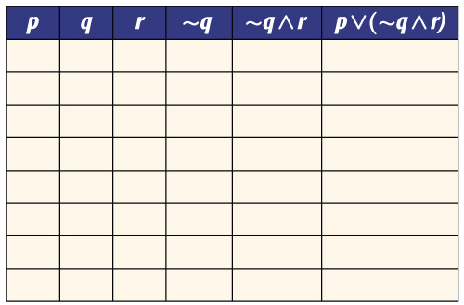
Example 3
Construct Truth Tables
B. Construct a truth table for p ∨ (~q ∧ r).
Step 1 Make columns with the headings p, q, r, ~q, ~q ∧ r, and p ∨ (~q ∧ r).

Slide 15
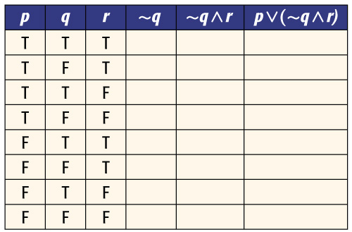
Example 3
Construct Truth Tables
B. Construct a truth table for p ∨ (~q ∧ r).
Step 2 List the possible combinations of truth values for p, q, and r.

Slide 16
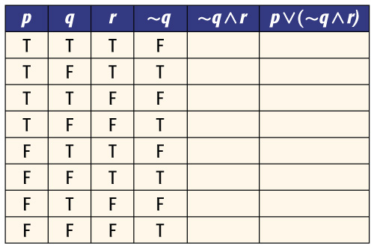
Example 3
Construct Truth Tables
B. Construct a truth table for p ∨ (~q ∧ r).
Step 3 Use the truth values of q to determine the truth values of ~q.

Slide 17
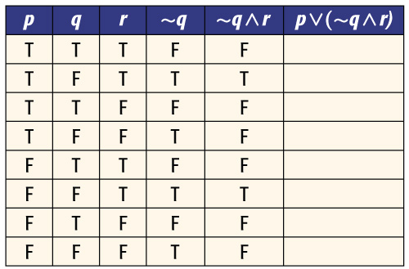
Example 3
Construct Truth Tables
B. Construct a truth table for p ∨ (~q ∧ r).
Step 4 Use the truth values for ~q and r to write the truth values for ~q ∧ r.

Slide 18
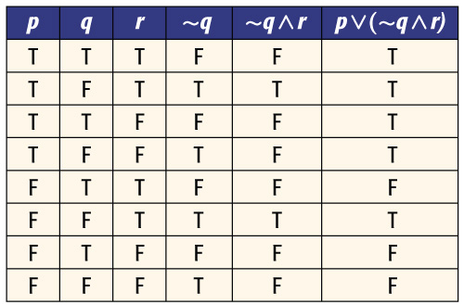
Example 3
Construct Truth Tables
B. Construct a truth table for p ∨ (~q ∧ r).
Step 5 Use the truth values for ~q ∧ r and p to write the truth values for p ∨ (~q ∧ r).
Answer:

Slide 19
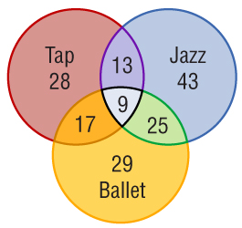
Example 4
Use Venn Diagrams
DANCING The Venn diagram shows the number of students enrolled in Monique’s Dance School for tap, jazz, and ballet classes.
A. How many students are enrolled in all three classes?
The students that are enrolled in all three classes are represented by the intersection of all three sets.
Answer: There are 9 students enrolled in all three classes.

Slide 20
Example 4
Use Venn Diagrams
DANCING The Venn diagram shows the number of students enrolled in Monique’s Dance School for tap, jazz, and ballet classes.
B. How many students are enrolled in tap or ballet?
The students that are enrolled in tap or ballet are represented by the union of these two sets.
Answer: There are 28 + 13 + 9 + 17 + 25 + 29 or 121 students enrolled in tap or ballet.

Slide 21
Example 4
Use Venn Diagrams
DANCING The Venn diagram shows the number of students enrolled in Monique’s Dance School for tap, jazz, and ballet classes.
C. How many students are enrolled in jazz and ballet, but not tap?
The students that are enrolled in jazz and ballet, but not tap, are represented by the intersection of jazz and ballet minus any students enrolled in tap.
Answer: There are 25 + 9 – 9 or 25 students enrolled in jazz and ballet, but not tap.

Slide 22
End of the Lesson

