Slide 1
Splash Screen

Slide 2
Then/Now
You identified and used special pairs of angles. (Lesson 1–5)
Write proofs involving supplementary and complementary angles.
Write proofs involving congruent and right angles.

Slide 3
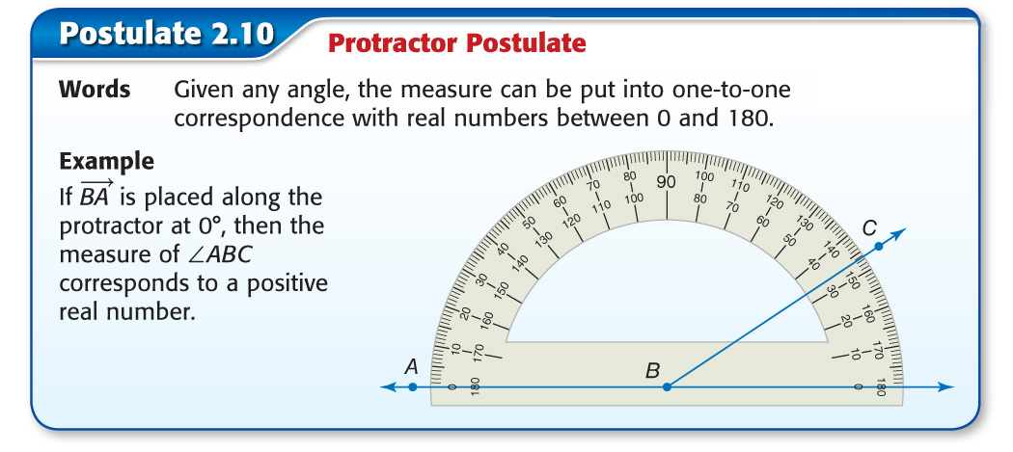
Concept

Slide 4
Concept

Slide 5
Example 1
Use the Angle Addition Postulate
CONSTRUCTION Using a protractor, a construction worker measures that the angle a beam makes with a ceiling is 42°. What is the measure of the angle the beam makes with the wall?
The ceiling and the wall make a 90° angle. Let ∠1 be the angle between the beam and the ceiling. Let ∠2 be the angle between the beam and the wall.
m∠1 + m∠2 = 90 Angle Addition Postulate
42 + m∠2 = 90 m∠1 = 42
42 – 42 + m∠2 = 90 – 42 Subtraction Property of Equality
m∠2 = 48 Substitution

Slide 6
Example 1
Use the Angle Addition Postulate
Answer: The beam makes a 48° angle with the wall.

Slide 7
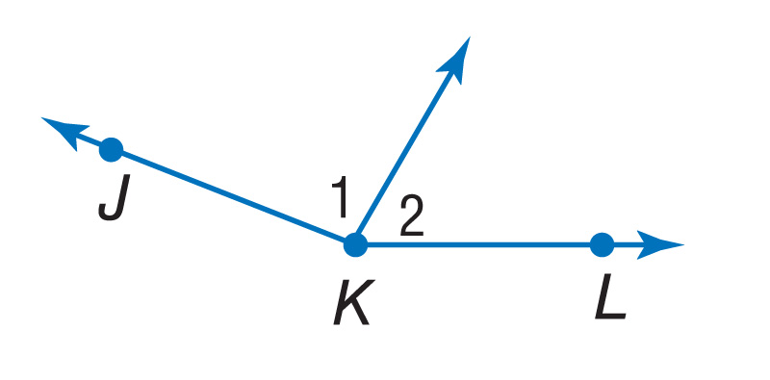
Example 1
Find m∠1 if m∠2 = 58 and m∠JKL = 162.
A. 32
B. 94
C. 104
D. 116
A
B
C
D

Slide 8
Concept

Slide 9
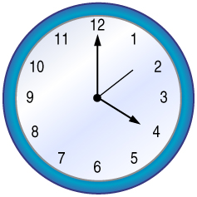
Example 2
Use Supplement or Complement
TIME At 4 o’clock, the angle between the hour and minute hands of a clock is 120º. When the second hand bisects the angle between the hour and minute hands, what are the measures of the angles between the minute and second hands and between the second and hour hands?
Understand Make a sketch of the situation. The time is 4 o’clock and the second hand bisects the angle between the hour and minute hands.

Slide 10
Example 2
Use Supplement or Complement
Plan Use the Angle Addition Postulate and the definition of angle bisector.
Solve Since the angles are congruent by the definition of angle bisector, each angle is 60°.
Answer: Both angles are 60°.
Check Use the Angle Addition Postulate to check your answer.
m∠1 + m∠2 = 120
60 + 60 = 120
120 = 120
✓

Slide 11
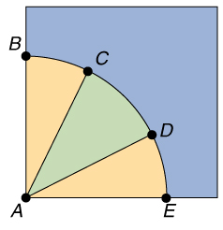
Example 2
QUILTING The diagram shows one square for a particular quilt pattern. If m∠BAC = m∠DAE = 20, and ∠BAE is a right angle, find m∠CAD.
A. 20
B. 30
C. 40
D. 50
A
B
C
D

Slide 12
Concept

Slide 13
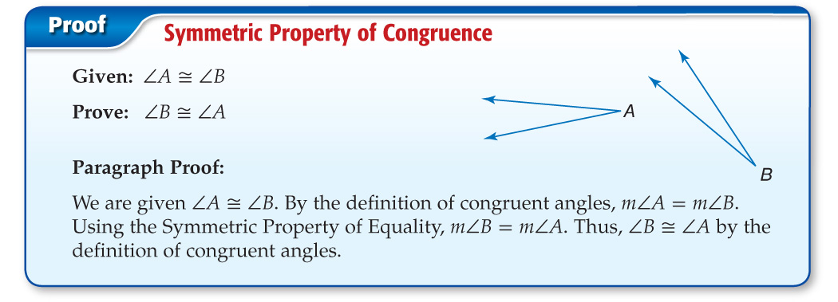
Concept

Slide 14
Concept

Slide 15
Concept

Slide 16
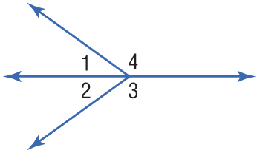
Example 3
Proofs Using Congruent Comp. or Suppl. Theorems
Given:
Prove:

Slide 17
Example 3
Proofs Using Congruent Comp. or Suppl. Theorems
Proof:
Statements Reasons
1. m∠3 + m∠1 = 180; ∠1 and ∠4 form a linear pair.
1. Given
2. ∠1 and ∠4 are supplementary.
2. Linear pairs are supplementary.
3. ∠3 and ∠1 are supplementary.
3. Definition of supplementary angles
4. ∠3 ≅ ∠4
4. ∠s suppl. to same ∠ are ≅.

Slide 18
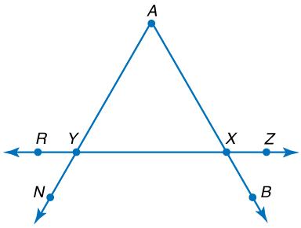
Example 3
In the figure, ∠NYR and ∠RYA form a linear pair, ∠AXY and ∠AXZ form a linear pair, and ∠RYA and ∠AXZ are congruent. Prove that ∠NYR and ∠AXY are congruent.

Slide 19
Example 3
Which choice correctly completes the proof?
Proof:
Statements Reasons
1. ∠NYR and ∠RYA, ∠AXY and ∠AXZ form linear pairs.
1. Given
2. ∠NYR and ∠RYA are supplementary. ∠AXY and ∠AXZ are supplementary.
2. If two ∠s form a linear pair, then they are suppl. ∠s.
3. ∠RYA ≅ ∠AXZ
3. Given
?
4. ∠NYR ≅ ∠AXY
4. ____________

Slide 20
Example 3
A. Substitution
B. Definition of linear pair
C. ∠s supp. to the same ∠ or to ≅ ∠s are ≅.
D. Definition of supplementary ∠s
A
B
C
D

Slide 21
Concept

Slide 22
Example 4
Use Vertical Angles
If ∠1 and ∠2 are vertical angles and m∠1 = d – 32 and m∠2 = 175 – 2d, find m∠1 and m∠2. Justify each step.
Proof:
Statements Reasons
1. ∠1 and ∠2 are vertical ∠s.
1. Given
2. ∠1 ≅ ∠2
2. Vertical Angles Theorem
3. m∠1 = m∠2
3. Definition of congruent angles
4. d – 32 = 175 – 2d
4. Substitution

Slide 23
Example 4
Use Vertical Angles
Statements Reasons
5. 3d – 32 = 175
5. Addition Property
6. 3d = 207
6. Addition Property
7. d = 69
7. Division Property
m∠1 = d – 32 m∠2 = 175 – 2d
= 69 – 32 or 37 = 175 – 2(69) or 37
Answer: m∠1 = 37 and m∠2 = 37

Slide 24
Example 4
A.
B.
C.
D.
A
B
C
D

Slide 25
Concept

Slide 26
End of the Lesson

