Slide 1
Splash Screen

Slide 2
Then/Now
You used angle and line segment relationships to prove theorems. (Lesson 2–8)
Identify relationships between two lines or two planes.
Name angle pairs formed by parallel lines and transversals.

Slide 3
Vocabulary
parallel lines
skew lines
parallel planes
transversal
interior angles
exterior angles
consecutive interior angles
alternate interior angles
alternate exterior angles
corresponding angles

Slide 4
Concept

Slide 5
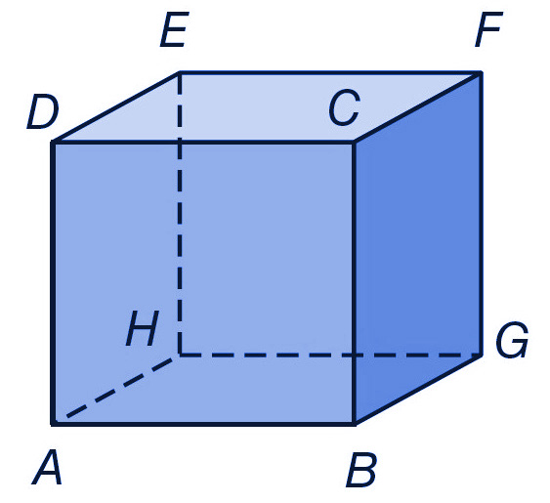
Example 1
Identify Parallel and Skew Relationships
A. Name all segments parallel to BC.
Answer: AD, EH, FG

Slide 6
Example 1
Identify Parallel and Skew Relationships
B. Name a segment skew to EH.
Answer: AB, CD, BG, or CF

Slide 7
Example 1
Identify Parallel and Skew Relationships
C. Name a plane parallel to plane ABG.
Answer: plane CDE

Slide 8
Concept

Slide 9
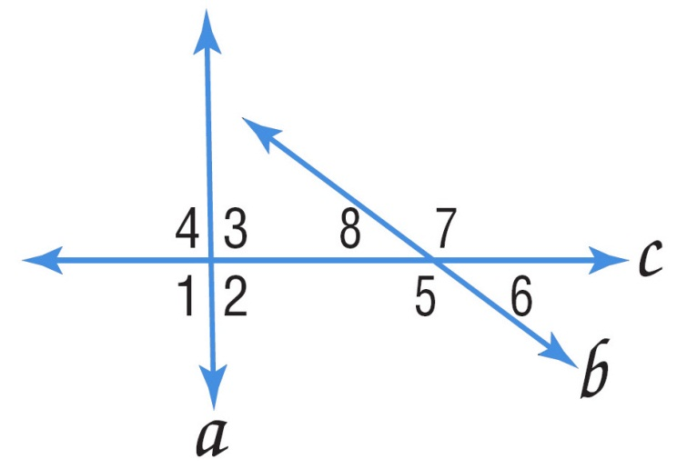
Example 2
Classify Angle Pair Relationships
A. Classify the relationship between ∠2 and ∠6 as alternate interior, alternate exterior, corresponding, or consecutive interior angles.
Answer: corresponding

Slide 10
Example 2
Classify Angle Pair Relationships
B. Classify the relationship between ∠1 and ∠7 as alternate interior, alternate exterior, corresponding, or consecutive interior angles.
Answer: alternate exterior

Slide 11
Example 2
Classify Angle Pair Relationships
C. Classify the relationship between ∠3 and ∠8 as alternate interior, alternate exterior, corresponding, or consecutive interior angles.
Answer: consecutive interior

Slide 12
Example 2
Classify Angle Pair Relationships
D. Classify the relationship between ∠3 and ∠5 as alternate interior, alternate exterior, corresponding, or consecutive interior angles.
Answer: alternate interior

Slide 13
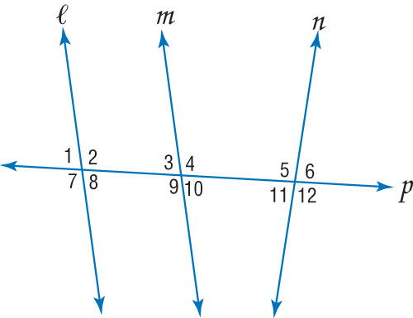
Example 2a
A. Classify the relationship between ∠4 and ∠5.
A. alternate interior
B. alternate exterior
C. corresponding
D. consecutive interior
A
B
C
D

Slide 14
Example 2b
B. Classify the relationship between ∠7 and ∠9.
A. alternate interior
B. alternate exterior
C. corresponding
D. consecutive interior
A
B
C
D

Slide 15
Example 2c
C. Classify the relationship between ∠4 and ∠7.
A. alternate interior
B. alternate exterior
C. corresponding
D. consecutive interior
A
B
C
D

Slide 16
Example 2d
D. Classify the relationship between ∠2 and ∠11.
A. alternate interior
B. alternate exterior
C. corresponding
D. consecutive interior
A
B
C
D

Slide 17
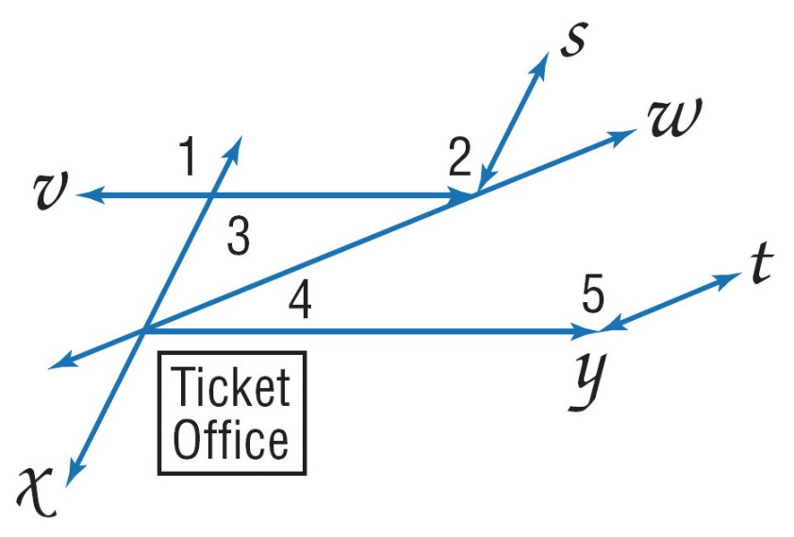
Example 3
Identify Transversals and Classify Angle Pairs
A. BUS STATION The driveways at a bus station are shown. Identify the transversal connecting ∠1 and ∠2. Then classify the relationship between the pair of angles.
Answer: The transversal connecting ∠1 and ∠2 is line v. These are corresponding angles.

Slide 18
Example 3
Identify Transversals and Classify Angle Pairs
B. BUS STATION The driveways at a bus station are shown. Identify the transversal connecting ∠2 and ∠3. Then classify the relationship between the pair of angles.
Answer: The transversal connecting ∠2 and ∠3 is line v. These are alternate interior angles.

Slide 19
Example 3
Identify Transversals and Classify Angle Pairs
C. BUS STATION The driveways at a bus station are shown. Identify the transversal connecting ∠4 and ∠5. Then classify the relationship between the pair of angles.
Answer: The transversal connecting ∠4 and ∠5 is line y. These are consecutive interior angles.

Slide 20
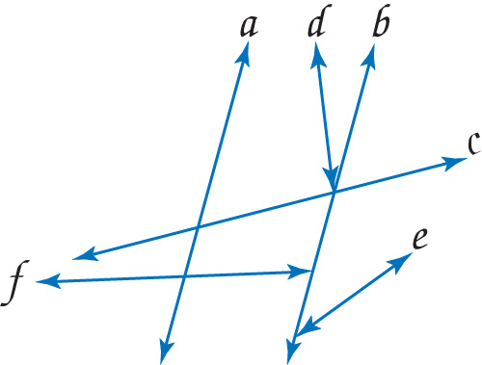
Example 3a
A. HIKING A group of nature trails is shown. Identify the sets of lines to which line a is a transversal.
A. lines c, f
B. lines c, d, e
C. lines c, d, f
D. lines c, d, e, f
A
B
C
D

Slide 21
Example 3b
B. HIKING A group of nature trails is shown. Identify the sets of lines to which line b is a transversal.
A. no lines
B. lines c, f
C. lines c, d, e, f
D. lines a, c, d, e, f
A
B
C
D

Slide 22
Example 3c
C. HIKING A group of nature trails is shown. Identify the sets of lines to which line c is a transversal.
A. no lines
B. lines a, b, d, e, f
C. lines a, d, f
D. lines a, b, e
A
B
C
D

Slide 23
End of the Lesson

