Slide 1
Splash Screen

Slide 2
Then/Now
You classified polygons with four sides as quadrilaterals. (Lesson 1–6)
Recognize and apply properties of the sides and angles of parallelograms.
Recognize and apply properties of the diagonals of parallelograms.

Slide 3
Vocabulary
parallelogram

Slide 4
Concept 1

Slide 5
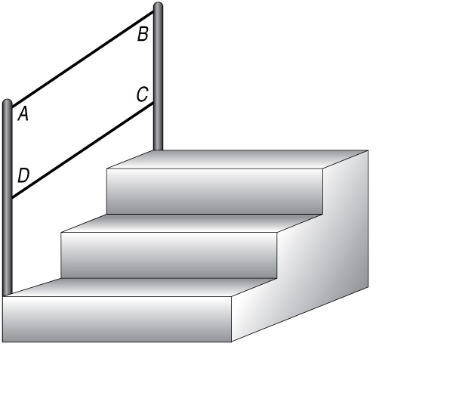
Example 1A
Use Properties of Parallelograms
A. CONSTRUCTION In suppose m∠B = 32, CD = 80 inches, BC = 15 inches. Find AD.

Slide 6
Example 1
Use Properties of Parallelograms
AD = BC Opposite sides of a are ≅.
= 15 Substitution
Answer: AD = 15 inches

Slide 7
Example 1B
Use Properties of Parallelograms
B. CONSTRUCTION In suppose m∠B = 32, CD = 80 inches, BC = 15 inches. Find m∠C.

Slide 8
Example 1
Use Properties of Parallelograms
m∠C + m∠B = 180 Cons. ∠s in a are supplementary.
m∠C + 32 = 180 Substitution
m∠C = 148 Subtract 32 from each side.
Answer: m∠C = 148

Slide 9
Example 1C
Use Properties of Parallelograms
C. CONSTRUCTION In suppose m∠B = 32, CD = 80 inches, BC = 15 inches. Find m∠D.

Slide 10
Example 1
Use Properties of Parallelograms
m∠D = m∠B Opp. ∠s of a are ≅.
= 32 Substitution
Answer: m∠D = 32

Slide 11
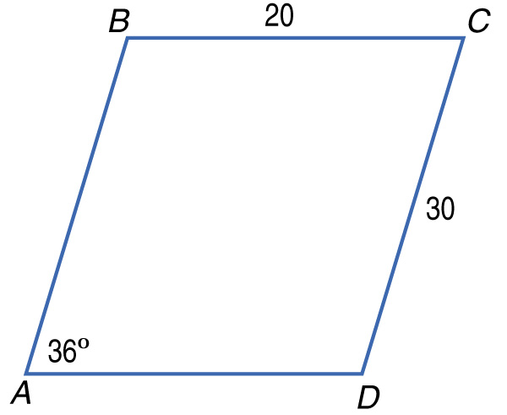
Example 1A
A. ABCD is a parallelogram. Find AB.
A. 10
B. 20
C. 30
D. 50
A
B
C
D

Slide 12
Example 1B
B. ABCD is a parallelogram. Find m∠C.
A. 36
B. 54
C. 144
D. 154
A
B
C
D

Slide 13
Example 1C
C. ABCD is a parallelogram. Find m∠D.
A. 36
B. 54
C. 144
D. 154
A
B
C
D

Slide 14
Concept 3

Slide 15
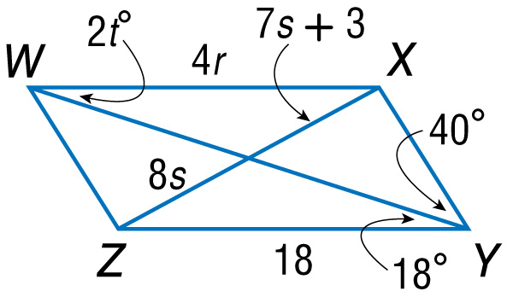
Example 2A
Use Properties of Parallelograms and Algebra
A. If WXYZ is a parallelogram, find the value of r.
Opposite sides of a parallelogram are ≅.
Definition of congruence
Substitution
Divide each side by 4.
Answer: r = 4.5

Slide 16
Example 2B
Use Properties of Parallelograms and Algebra
B. If WXYZ is a parallelogram, find the value of s.
8s = 7s + 3 Diagonals of a bisect each other.
s = 3 Subtract 7s from each side.
Answer: s = 3

Slide 17
Example 2C
Use Properties of Parallelograms and Algebra
C. If WXYZ is a parallelogram, find the value of t.
ΔWXY ≅ ΔYZW Diagonal separates a parallelogram into 2 ≅ triangles.
∠YWX ≅ ∠WYZ CPCTC
m∠YWX = m∠WYZ Definition of congruence

Slide 18
Example 2C
Use Properties of Parallelograms and Algebra
2t = 18 Substitution
t = 9 Divide each side by 2.
Answer: t = 9

Slide 19
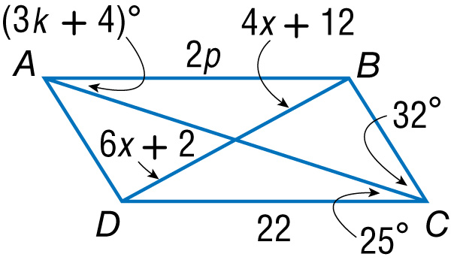
Example 2A
A. If ABCD is a parallelogram, find the value of x.
A. 2
B. 3
C. 5
D. 7
A
B
C
D

Slide 20
Example 2B
B. If ABCD is a parallelogram, find the value of p.
A. 4
B. 8
C. 10
D. 11
A
B
C
D

Slide 21
Example 2C
C. If ABCD is a parallelogram, find the value of k.
A. 4
B. 5
C. 6
D. 7
A
B
C
D

Slide 22
Example 3
Parallelograms and Coordinate Geometry
What are the coordinates of the intersection of the diagonals of parallelogram MNPR, with vertices M(–3, 0), N(–1, 3), P(5, 4), and R(3, 1)?
Since the diagonals of a parallelogram bisect each other, the intersection point is the midpoint of
Find the midpoint of
Midpoint Formula

Slide 23
Example 3
Parallelograms and Coordinate Geometry
Answer: The coordinates of the intersection of the diagonals of parallelogram MNPR are (1, 2).

Slide 24
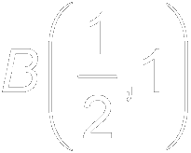
Example 3
What are the coordinates of the intersection of the diagonals of parallelogram LMNO, with vertices L(0, –3), M(–2, 1), N(1, 5), O(3, 1)?
A.
B.
C.
D.
A
B
C
D

Slide 25
End of the Lesson

