Slide 1
Splash Screen

Slide 2
Then/Now
You determined whether quadrilaterals were parallelograms and/or rectangles. (Lesson 6–4)
Recognize and apply the properties of rhombi and squares.
Determine whether quadrilaterals are rectangles, rhombi, or squares.

Slide 3
Vocabulary
rhombus
square

Slide 4
Concept 1

Slide 5
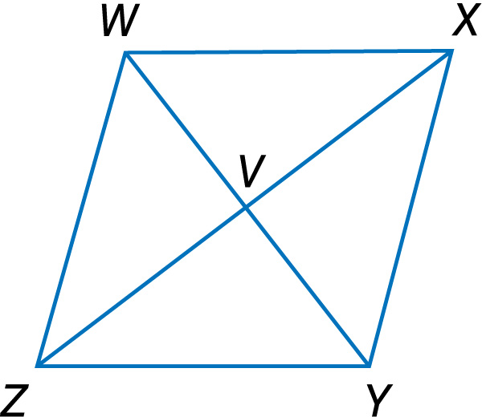
Example 1A
Use Properties of a Rhombus
A. The diagonals of rhombus WXYZ intersect at V. If m∠WZX = 39.5, find m∠ZYX.

Slide 6
Example 1A
Use Properties of a Rhombus
Since WXYZ is a rhombus, diagonal ZX bisects ∠WZY. Therefore, m∠WZY = 2m∠WZX. So, m∠WZY = 2(39.5) or 79. Since WXYZ is a rhombus, WZ║XY, and ZY is a transversal.
m∠WZY + m∠ZYX = 180 Consecutive Interior Angles Theorem
79 + m∠ZYX = 180 Substitution
m∠ZYX = 101 Subtract 79 from both sides.
Answer: m∠ZYX = 101

Slide 7
Example 1B
Use Properties of a Rhombus
B. ALGEBRA The diagonals of rhombus WXYZ intersect at V. If WX = 8x – 5 and WZ = 6x + 3, find x.

Slide 8
Example 1B
Use Properties of a Rhombus
WX ≅ WZ By definition, all sides of a rhombus are congruent.
WX = WZ Definition of congruence
8x – 5 = 6x + 3 Substitution
2x – 5 = 3 Subtract 6x from each side.
2x = 8 Add 5 to each side.
x = 4 Divide each side by 4.
Answer: x = 4

Slide 9
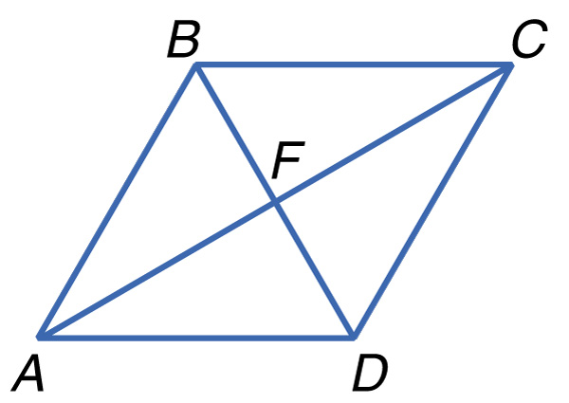
Example 1A
A. ABCD is a rhombus. Find m∠CDB if m∠ABC = 126.
A. m∠CDB = 126
B. m∠CDB = 63
C. m∠CDB = 54
D. m∠CDB = 27
A
B
C
D

Slide 10
Example 1B
B. ABCD is a rhombus. If BC = 4x – 5 and CD = 2x + 7, find x.
A. x = 1
B. x = 3
C. x = 4
D. x = 6
A
B
C
D

Slide 11
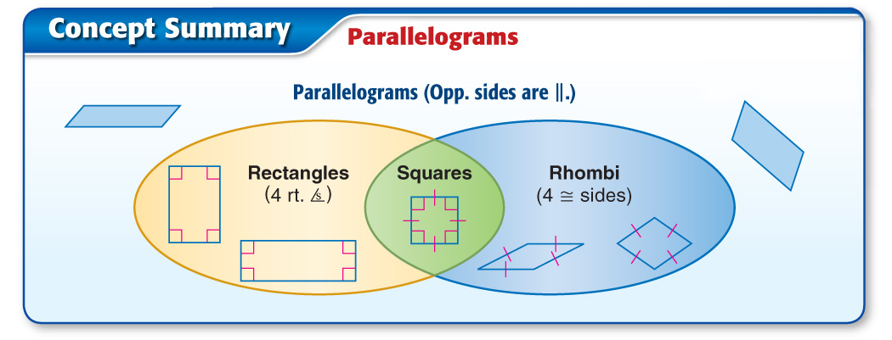
Concept 3

Slide 12
Concept

Slide 13
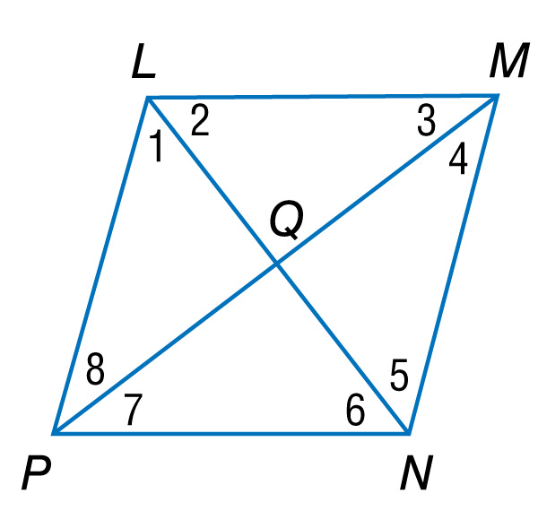
Example 2
Proofs Using Properties of Rhombi and Squares
Write a paragraph proof.
Given: LMNP is a parallelogram. ∠1 ≅ ∠2 and ∠2 ≅ ∠6
Prove: LMNP is a rhombus.

Slide 14
Example 2
Proofs Using Properties of Rhombi and Squares
Proof: Since it is given that LMNP is a parallelogram, LM║PN and ∠1 and ∠5 are alternate interior angles. Therefore, ∠1 ≅ ∠5. It is also given that ∠1 ≅ ∠2 and ∠2 ≅ ∠6, so ∠1 ≅ ∠6 by substitution and ∠5 ≅ ∠6 by substitution.
Answer: Therefore, LN bisects ∠L and ∠N. By Theorem 6.18, LMNP is a rhombus.

Slide 15
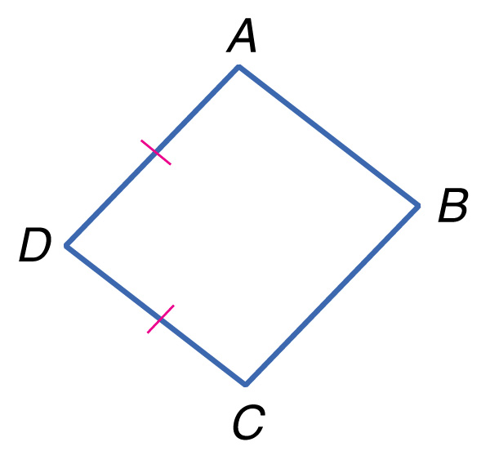
Example 2
Is there enough information given to prove that ABCD is a rhombus?
Given: ABCD is a parallelogram. AD ≅ DC
Prove: ADCD is a rhombus

Slide 16
Example 2
A. Yes, if one pair of consecutive sides of a parallelogram are congruent, the parallelogram is a rhombus.
B. No, you need more information.
A
B

Slide 17
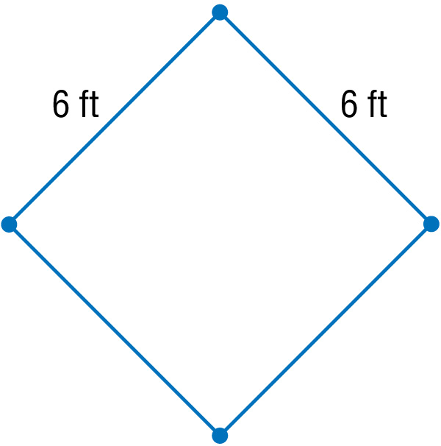
Example 3
Use Conditions for Rhombi and Squares
GARDENING Hector is measuring the boundary of a new garden. He wants the garden to be square. He has set each of the corner stakes 6 feet apart. What does Hector need to know to make sure that the garden is square?

Slide 18
Example 3
Use Conditions for Rhombi and Squares
Answer: Since opposite sides are congruent, the garden is a parallelogram. Since consecutive sides are congruent, the garden is a rhombus. Hector needs to know if the diagonals of the garden are congruent. If they are, then the garden is a rectangle. By Theorem 6.20, if a quadrilateral is a rectangle and a rhombus, then it is a square.

Slide 19
Example 3
Sachin has a shape he knows to be a parallelogram and all four sides are congruent. Which information does he need to know to determine whether it is also a square?
A. The diagonal bisects a pair of opposite angles.
B. The diagonals bisect each other.
C. The diagonals are perpendicular.
D. The diagonals are congruent.
A
B
C
D

Slide 20
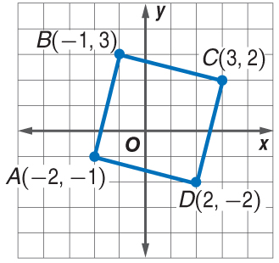
Example 4
Classify Quadrilaterals Using Coordinate Geometry
Determine whether parallelogram ABCD is a rhombus, a rectangle, or a square for A(–2, –1), B(–1, 3), C(3, 2), and D(2, –2). List all that apply. Explain.
Understand Plot the vertices on a coordinate plane.

Slide 21
Example 4
Classify Quadrilaterals Using Coordinate Geometry
It appears from the graph that the parallelogram is a rhombus, rectangle, and a square.
Plan If the diagonals are perpendicular, then ABCD is either a rhombus or a square. The diagonals of a rectangle are congruent. If the diagonals are congruent and perpendicular, then ABCD is a square.
Solve Use the Distance Formula to compare the lengths of the diagonals.

Slide 22
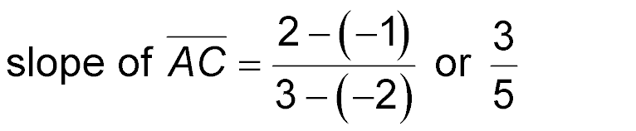
Example 4
Classify Quadrilaterals Using Coordinate Geometry
Use slope to determine whether the diagonals are perpendicular.

Slide 23
Example 4
Classify Quadrilaterals Using Coordinate Geometry
Since the slope of is the negative reciprocal of the slope of the diagonals are perpendicular. The lengths of and are the same, so the diagonals are congruent.
Answer: ABCD is a rhombus, a rectangle, and a square.
Check You can verify ABCD is a square by using the Distance Formula to show that all four sides are congruent and by using the Slope Formula to show consecutive sides are perpendicular.

Slide 24
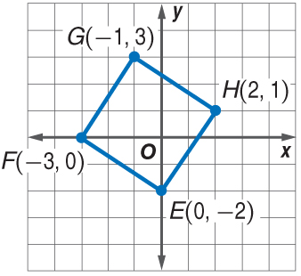
Example 4
Determine whether parallelogram EFGH is a rhombus, a rectangle, or a square for E(0, –2), F(–3, 0), G(–1, 3), and H(2, 1). List all that apply.
A. rhombus only
B. rectangle only
C. rhombus, rectangle, and square
D. none of these
A
B
C
D

Slide 25
End of the Lesson

