Slide 1
Splash Screen

Slide 2
Then/Now
You analyzed graphs of functions. (Lesson 1-2)
Graph polynomial functions.
Model real-world data with polynomial functions.

Slide 3
Vocabulary
polynomial function
polynomial function of degree n
leading coefficient
leading-term test
quartic function
turning point
quadratic form
repeated zero
multiplicity

Slide 4
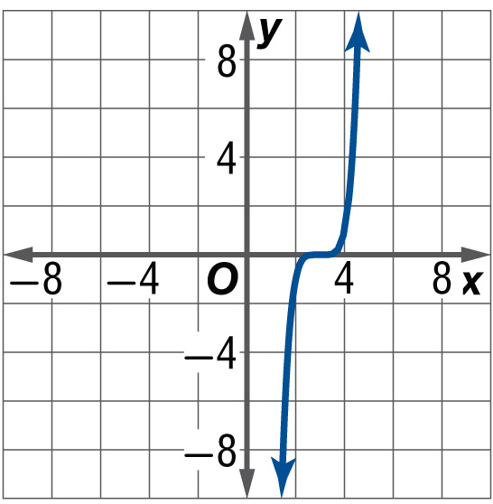
Example 1
Graph Transformations of Monomial Functions
A. Graph f (x) = (x – 3)⁵.
This is an odd-degree function, so its graph is similar to the graph of y = x ³. The graph of f(x) = (x – 3)⁵ is the graph of y = x ⁵ translated 3 units to the right.
Answer:

Slide 5
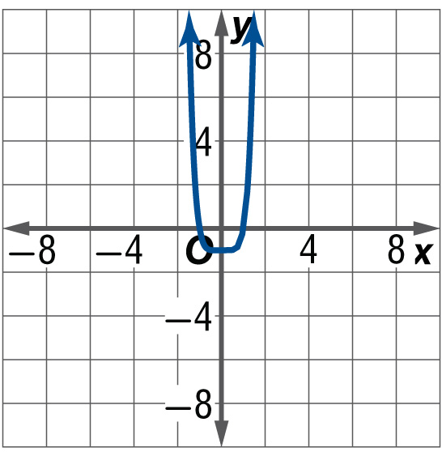
Example 1
Graph Transformations of Monomial Functions
B. Graph f (x) = x ⁶ – 1.
This is an even-degree function, so its graph is similar to the graph of y = x ². The graph of f(x) = x ⁶ – 1 is the graph of y = x ⁶ translated 1 unit down.
Answer:

Slide 6
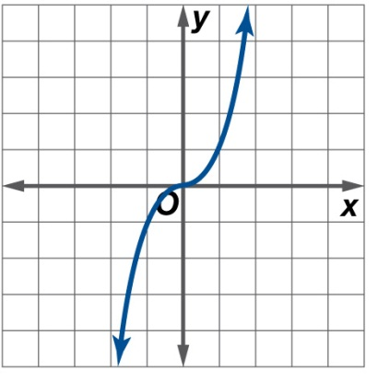
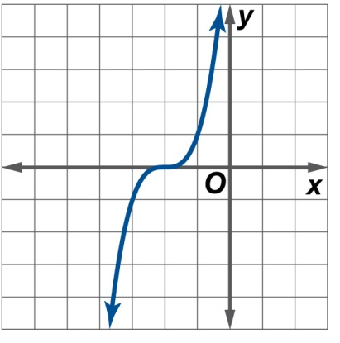
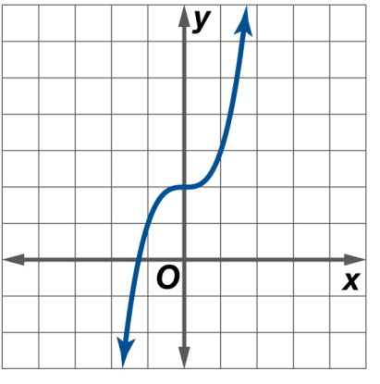
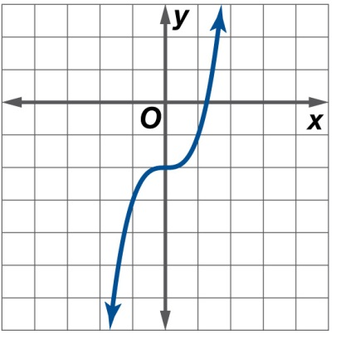
Example 1
Graph f (x) = 2 + x ³.
A.
B.
C.
D.

Slide 7
Key Concept 1

Slide 8
Example 2
Apply the Leading Term Test
A. Describe the end behavior of the graph of f (x) = 3x ⁴ – x ³ + x ² + x – 1 using limits. Explain your reasoning using the leading term test.
The degree is 4, and the leading coefficient is 3. Because the degree is even and the leading coefficient is positive, .
Answer:

Slide 9
Example 2
Apply the Leading Term Test
B. Describe the end behavior of the graph of f (x) = –3x ² + 2x ⁵ – x ³ using limits. Explain your reasoning using the leading term test.
Write in standard form as f (x) = 2x ⁵ – x ³ – 3x ². The degree is 5, and the leading coefficient is 2. Because the degree is odd and the leading coefficient is positive, .
Answer:

Slide 10
Example 2
Apply the Leading Term Test
C. Describe the end behavior of the graph of f (x) = –2x ⁵ – 1 using limits. Explain your reasoning using the leading term test.
The degree is 5 and the leading coefficient is –2. Because the degree is odd and the leading coefficient is negative, .
Answer:

Slide 11
Example 2
Describe the end behavior of the graph of g (x) = –3x ⁵ + 6x ³ – 2 using limits. Explain your reasoning using the leading term test.
A. Because the degree is odd and the leading coefficient negative, .
B. Because the degree is odd and the leading coefficient negative, .
C. Because the degree is odd and the leading coefficient negative, .
D. Because the degree is odd and the leading coefficient negative, .

Slide 12
Key Concept 2

Slide 13
Example 3
Zeros of a Polynomial Function
State the number of possible real zeros and turning points of f (x) = x ³ + 5x ² + 4x. Then determine all of the real zeros by factoring.
The degree of the function is 3, so f has at most 3 distinct real zeros and at most 3 – 1 or 2 turning points. To find the real zeros, solve the related equation f (x) = 0 by factoring.
x ³ + 5x ² + 4x = 0 Set f (x) equal to 0.
x(x ² + 5x + 4) = 0 Factor the greatest common factor, x.
x(x + 4)(x + 1) = 0 Factor completely.

Slide 14
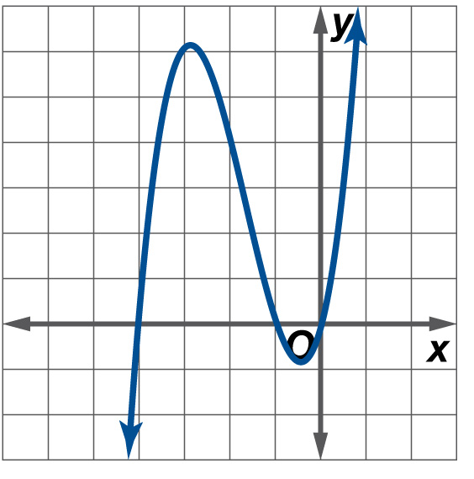
Example 3
Zeros of a Polynomial Function
So, f has three distinct real zeros, x = 0, x = –4, and x = –1. This is consistent with a cubic function having at most 3 distinct real zeros.
CHECK You can use a graphing calculator to graph f (x) = x ³ + 5x ² + 4x and confirm these zeros. Additionally, you can see that the graph has 2 turning points, which is consistent with cubic functions having at most 2 turning points.

Slide 15
Example 3
Zeros of a Polynomial Function
Answer: The degree is 3, so f has at most 3 distinct real zeros and at most 2 turning points. f (x) = x ³ + 5x ² + 4x = x (x + 1)(x + 4), so f has three zeros, x = 0, x = –1, and x = –4.

Slide 16
Example 3
State the number of possible real zeros and turning points of f (x) = x ⁴ – 13x ² + 36. Then determine all of the real zeros by factoring.
A. 4 possible real zeros, 3 turning points; zeros 2, –2, 3, –3
B. 4 possible real zeros, 2 turning points; zeros 4, 9
C. 3 possible real zeros, 2 turning points; zeros 2, 3
D. 4 possible real zeros, 4 turning points; zeros –2, –3

Slide 17
Key Concept 3

Slide 18
Example 4
Zeros of a Polynomial Function in Quadratic Form
State the number of possible real zeros and turning points for h (x) = x ⁴ – 4x ² + 3. Then determine all of the real zeros by factoring.
The degree of the function is 4, so h has at most 4 distinct real zeros and at most 4 – 1 or 3 turning points. This function is in quadratic form because x ⁴ – 4x ² + 3 = (x ²)² – 4(x ²) + 3. Let u = x ².
(x²)² – 4(x²) + 3 = 0 Set h(x) equal to 0.
u² – 4u + 3 = 0 Substitute u for x².
(u – 3)(u – 1) = 0 Factor the quadratic expression.

Slide 19
Example 4
Zeros of a Polynomial Function in Quadratic Form
(x ² – 3)(x ² – 1) = 0 Substitute x ² for u.
Factor completely.
Zero Product Property
or x + 1 = 0 or x – 1 = 0
, x = –1 x = 1 Solve for x.
h has four distinct real zeros, , –1, and 1. This is consistent with a quartic function. The graph of h (x) = x ⁴ – 4x ² + 3 confirms this. Notice that there are 3 turning points, which is also consistent with a quartic function.

Slide 20
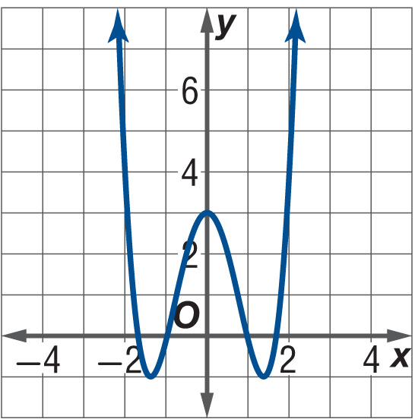
Example 4
Zeros of a Polynomial Function in Quadratic Form
Answer: The degree is 4, so h has at most 4 distinct real zeros and at most 3 turning points. h (x) = x ⁴ – 4x ² + 3 = (x ² – 3)(x – 1)(x + 1), so h has four distinct real zeros, x = , x = –1, and x = 1.

Slide 21
Example 4
State the number of possible real zeros and turning points of g (x) = x ⁵ – 5x ³ – 6x. Then determine all of the real zeros by factoring.
A. 3 possible real zeros, 2 turning points; real zeros 0, –1, 6
B. 5 possible real zeros, 4 turning points; real zeros 0,
C. 3 possible real zeros, 3 turning points; real zeros 0, –1, .
D. 5 possible real zeros, 4 turning points; real zeros 0, 1, –1,

Slide 22
Example 5
Polynomial Function with Repeated Zeros
State the number of possible real zeros and turning points of h (x) = x ⁴ + 5x ³ + 6x ². Then determine all of the real zeros by factoring.
The degree of the function is 4, so it has at most 4 distinct real zeros and at most 4 – 1 or 3 turning points. Find the real zeros.
x ⁴ + 5x ³ + 6x ² = 0 Set h(x) equal to 0.
x ²(x ² + 5x + 6) = 0 Factor the greatest common factor, x ².
x ²(x + 3)(x + 2) = 0 Factor completely.

Slide 23
Example 5
Polynomial Function with Repeated Zeros
The expression above has 4 factors, but solving for x yields only 3 distinct real zeros, x = 0, x = –3, and x = –2. Of the zeros, x = 0 is repeated.
The graph of h (x) = x ⁴ + 5x ³ + 6x ² shown here confirms these zeros and shows that h has three turning points. Notice that at x = –3 and x = –2, the graph crosses the x-axis, but at x = 0, the graph is tangent to the x-axis.

Slide 24
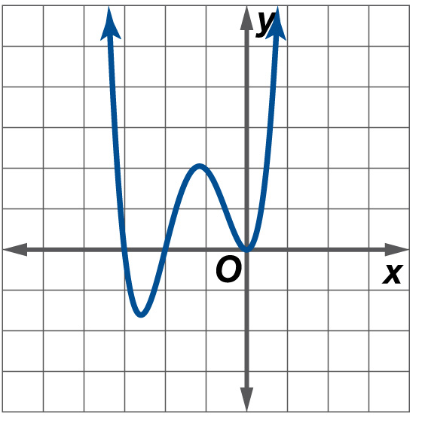
Example 5
Polynomial Function with Repeated Zeros
Answer: The degree is 4, so h has at most 4 distinct real zeros and at most 3 turning points. h (x) = x ⁴ + 5x ³ + 6x ² = x ²(x + 2)(x + 3), so h has three zeros, x = 0, x = –2, and x = –3. Of the zeros, x = 0 is repeated.

Slide 25
Example 5
State the number of possible real zeros and turning points of g (x) = x ⁴ – 4x ³ + 4x ². Then determine all of the real zeros by factoring.
A. 4 possible real zeros, 3 turning points; real zeros 0, 2
B. 4 possible real zeros, 3 turning points; real zeros 0, 2, –2
C. 2 possible real zeros, 1 turning point; real zeros 2, –2
D. 4 possible real zeros, 3 turning points; real zeros 0, –2

Slide 26
Key Concept 4

Slide 27
Example 6
Graph a Polynomial Function
A. For f (x) = x(3x + 1) (x – 2) ², apply the leading-term test.
The product x(3x + 1)(x – 2)² has a leading term of x(3x)(x)² or 3x⁴, so f has degree 4 and leading coefficient 3. Because the degree is even and the leading coefficient is positive, .
Answer:

Slide 28
Example 6
Graph a Polynomial Function
B. For f (x) = x(3x + 1) (x – 2) ², determine the zeros and state the multiplicity of any repeated zeros.
The distinct real zeros are x = 0, x = , and x = 2. The zero at x = 2 has multiplicity 2.
Answer: 0, , 2 (multiplicity: 2)

Slide 29
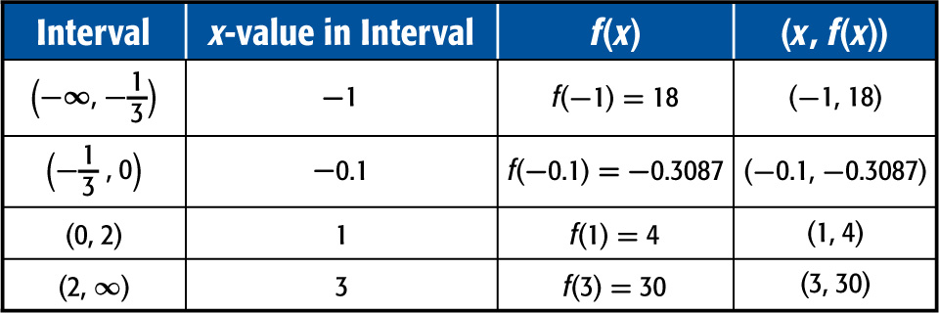
Example 6
Graph a Polynomial Function
C. For f (x) = x(3x + 1) (x – 2) ², find a few additional points.
Choose x-values that fall in the intervals determined by the zeros of the function.
Answer: (–1, 18), (–0.1, –0.3087), (1, 4), (3, 30)

Slide 30
Example 6
Graph a Polynomial Function
D. For f (x) = x(3x + 1) (x – 2) ², graph the function.
Plot the points you found. The end behavior of the function tells you that the graph eventually rises to the left and to the right. You also know that the graph crosses the x-axis at nonrepeated zeros x = and x = 0, but does not cross the x-axis at repeated zero x = 2, because its multiplicity is even. Draw a continuous curve through the points as shown in the figure.

Slide 31
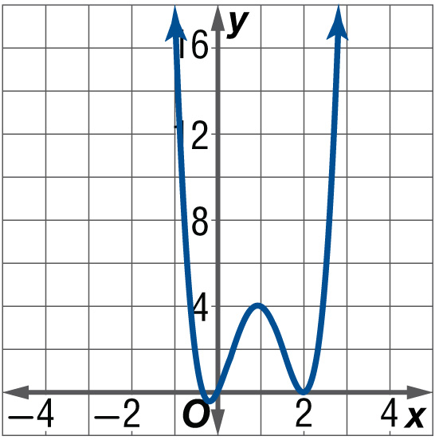
Example 6
Graph a Polynomial Function
Answer:

Slide 32
Example 6
Determine the zeros and state the multiplicity of any repeated zeros for f (x) = 3x(x + 2)²(2x – 1)³.
A. 0, –2 (multiplicity 2), (multiplicity 3)
B. 2 (multiplicity 2), – (multiplicity 3)
C. 4 (multiplicity 2), (multiplicity 3)
D. –2 (multiplicity 2), (multiplicity 3)

Slide 33
End of the Lesson

