Slide 1
Splash Screen

Slide 2
Then/Now
You identified, graphed, and described several parent functions. (Lesson 1-5)
Evaluate, analyze, and graph exponential functions.
Solve problems involving exponential growth and decay.

Slide 3
Vocabulary
algebraic function
transcendental function
exponential function
natural base
continuous compound interest

Slide 4
Key Concept 1

Slide 5
Example 1
Sketch and Analyze Graphs of Exponential Functions
A. Sketch and analyze the graph of f (x) = 4^{x}. Describe its domain, range, intercepts, asymptotes, end behavior, and where the function is increasing or decreasing.
Evaluate the function for several x-values in its domain. Then use a smooth curve to connect each of these ordered pairs.

Slide 6
Example 1
Sketch and Analyze Graphs of Exponential Functions
Answer: Domain: ; Range: ; y-intercept: 1; Asymptote: x-axis; End behavior: ; Increasing:

Slide 7
Example 1
Sketch and Analyze Graphs of Exponential Functions
B. Sketch and analyze the graph of f (x) = 5^{–x}. Describe its domain, range, intercepts, asymptotes, end behavior, and where the function is increasing or decreasing.
Evaluate the function for several x-values in its domain. Then use a smooth curve to connect each of these ordered pairs.

Slide 8
Example 1
Sketch and Analyze Graphs of Exponential Functions
Answer: Domain: ; Range: ; y-intercept: 1; Asymptote: x-axis; End behavior: ; Decreasing: ;

Slide 9
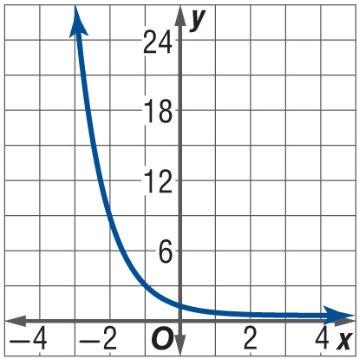
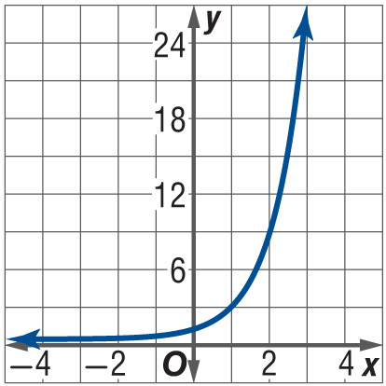
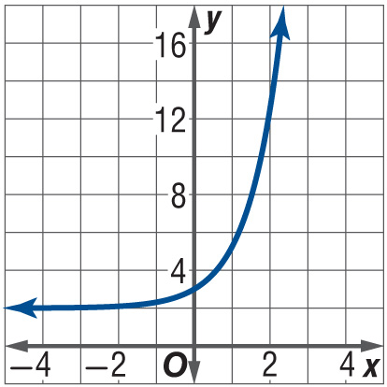
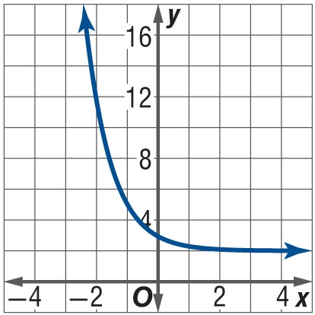
Example 1
A. Sketch and analyze the graph of f (x) = 3^{–x}.
A.
B.
C.
D.

Slide 10
Example 1
B. Describe domain, range, intercepts, asymptotes, end behavior, and when the function is increasing or decreasing of f (x) = 3^{–x}.
A. Domain: (–∞, ∞); Range: (0, ∞); y-intercept: 1; Asymptote: x-axis; End behavior: ; Decreasing: (–∞, ∞);
B. Domain: (–∞, ∞); Range: (0, ∞); y-intercept: 1; Asymptote: x-axis; End behavior: ; Increasing: (–∞, ∞);
C. Domain: (–∞, ∞); Range: (0, ∞); y-intercept: 3; Asymptote: y = 2; End behavior: ; Increasing: (–∞, ∞);
D. Domain: (–∞, ∞); Range: (0, ∞); y-intercept: 3; Asymptote: y = 2; End behavior: ; Decreasing: (–∞, ∞);

Slide 11
Key Concept 2

Slide 12
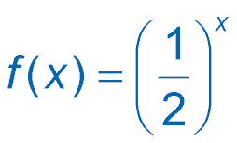
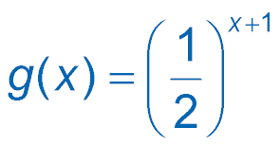
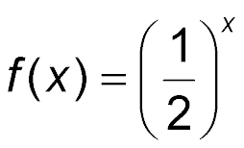
Example 2
Graph Transformations of Exponential Functions
A. Use the graph of to describe the transformation that results in . Then sketch the graph of the function.
This function is of the form g (x) = f (x + 1). Therefore, the graph of g (x) is the graph of translated 1 unit to the left.

Slide 13
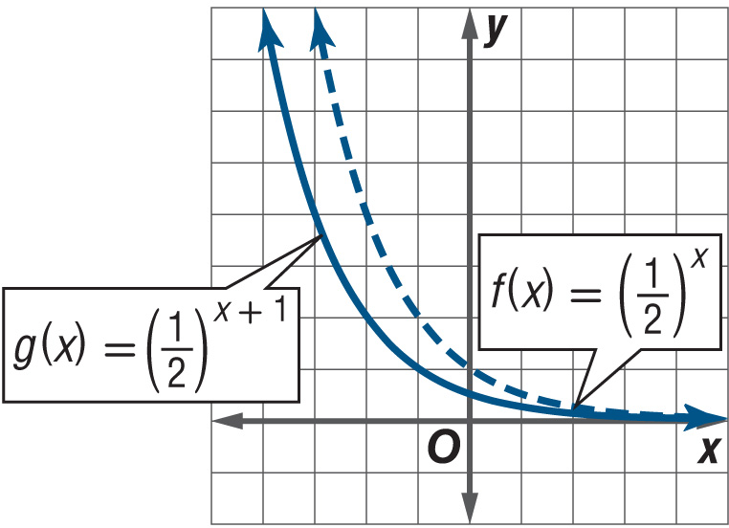
Example 2
Graph Transformations of Exponential Functions
Answer: g (x) is the graph of f (x) translated 1 unit to the left.

Slide 14
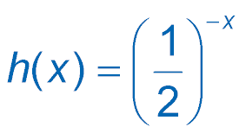
Example 2
Graph Transformations of Exponential Functions
B. Use the graph of to describe the transformation that results in . Then sketch the graph of the function.
This function is of the form h (x) = f(–x). Therefore, the graph of h (x) is the graph of reflected in the y-axis.

Slide 15
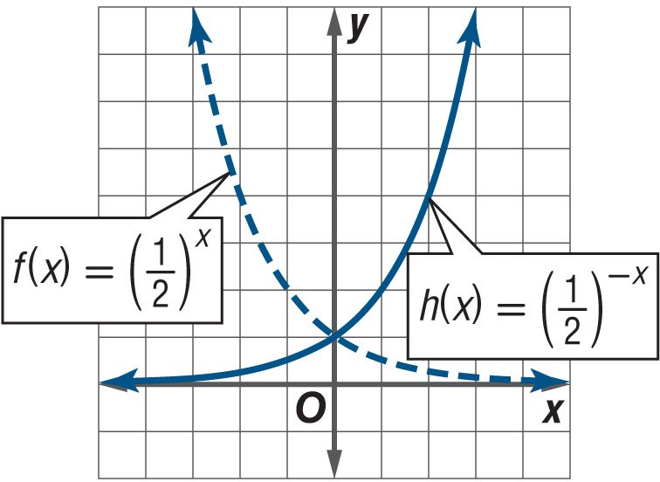
Example 2
Graph Transformations of Exponential Functions
Answer: h (x) is the graph of f (x) reflected in the y-axis.

Slide 16
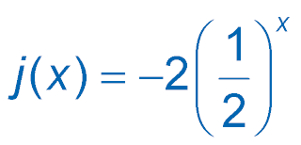
Example 2
Graph Transformations of Exponential Functions
C. Use the graph of to describe the transformation that results in . Then sketch the graph of the function.
This function is of the form j (x) = –2f(x). Therefore, the graph of j (x) is the graph of reflected in the x-axis and expanded vertically by a factor of 2.

Slide 17
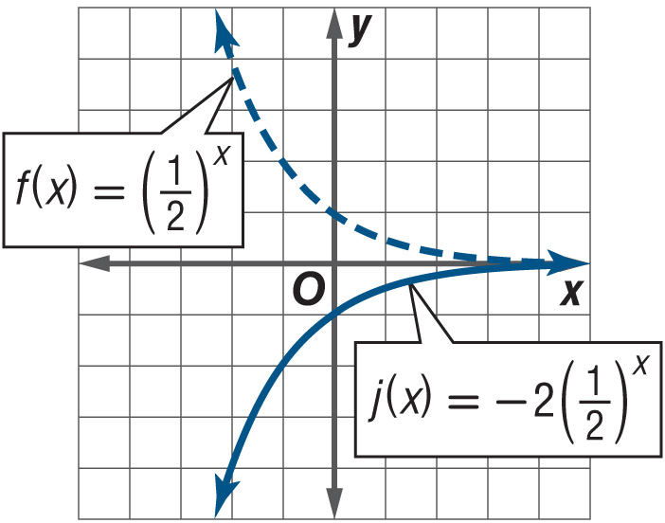
Example 2
Graph Transformations of Exponential Functions
Answer: j (x) is the graph of f (x) reflected in the x-axis and expanded vertically by a factor of 2.

Slide 18
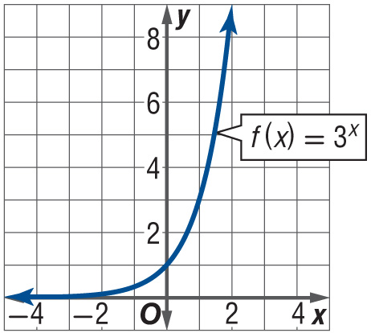
Example 2
Use the graph of f (x) = 3^{x} to describe the transformation that results in p (x) = 3^{x – 1}. Then sketch the graph of the function.

Slide 19
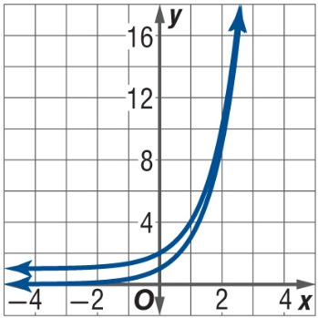
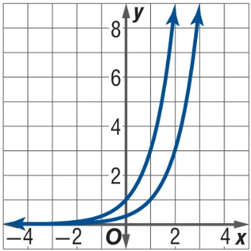
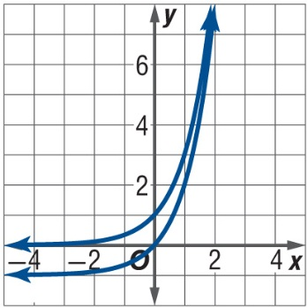
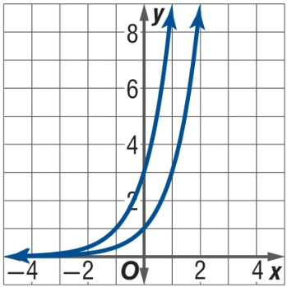
Example 2
A. p (x) is the graph of f (x) = 3^{x} translated 1 unit up.
B. p (x) is the graph of f (x) = 3^{x} translated 1 unit down.
C. p (x) is the graph of f (x) = 3^{x} translated 1 unit to the right.
D. p (x) is the graph of f (x) = 3^{x} translated 1 unit to the left.

Slide 20
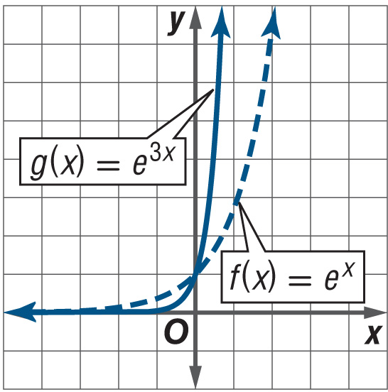
Example 3
Graph Natural Base Exponential Functions
A. Use the graph of f (x) = e ^{x} to describe the transformation that results in g (x) = e^{3x}. Then sketch the graph of the function.
This function is of the form g (x) = f(3x). Therefore, the graph of g (x) is the graph of f (x) = e^{x} compressed horizontally by a factor of 3.
Answer: g (x) is the graph of f (x) compressed horizontally by a factor of 3.

Slide 21
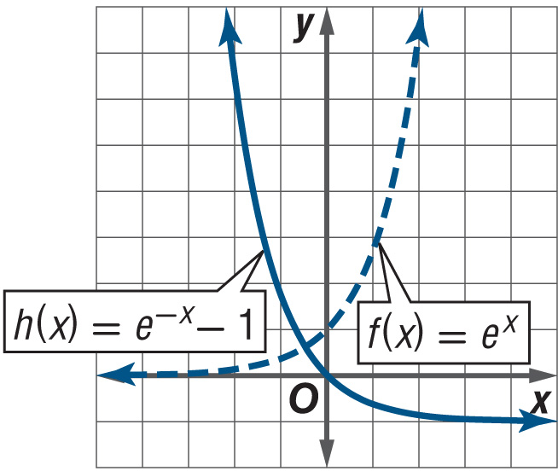
Example 3
Graph Natural Base Exponential Functions
B. Use the graph of f (x) = e^{x} to describe the transformation that results in h (x) = e^{–x} – 1. Then sketch the graph of the function.
This function is of the form h (x) = f(–x) – 1. Therefore, the graph of h (x) is the graph of f (x) = e^{x} reflected in the y-axis and translated 1 unit down.
Answer: h (x) is the graph of f (x) reflected in the y-axis and translated 1 unit down.

Slide 22
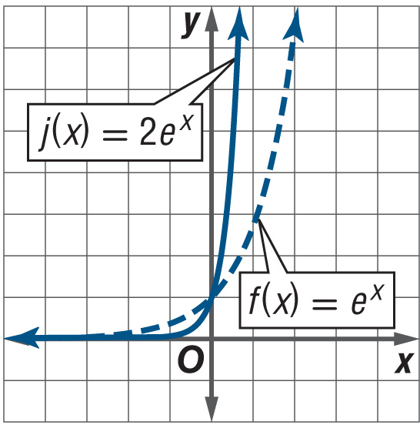
Example 3
Graph Natural Base Exponential Functions
C. Use the graph of f (x) = e^{x} to describe the transformation that results in j (x) = 2e^{x}. Then sketch the graph of the function.
This function is of the form j (x) = 2f(x). Therefore, the graph of j (x) is the graph of f (x) = e ^{x} expanded vertically by a factor of 2.
Answer: j (x) is the graph of f (x) expanded vertically by a factor of 2.

Slide 23
Example 3
A. Use the graph of f (x) = e^{x} to describe the transformation that results in p (x) = e^{x} + 2. Then sketch the graph of the function.
A. p (x) is the graph of f (x) = e^{x} translated 2 units left.
B. p (x) is the graph of f (x) = e^{x} translated 2 units right.
C. p (x) is the graph of f (x) = e^{x} translated 2 units down.
D. p (x) is the graph of f (x) = e^{x} translated 2 units up.

Slide 24
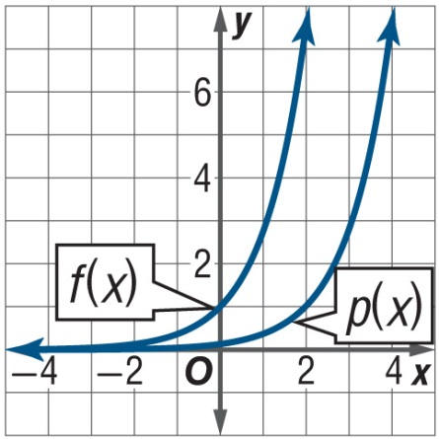
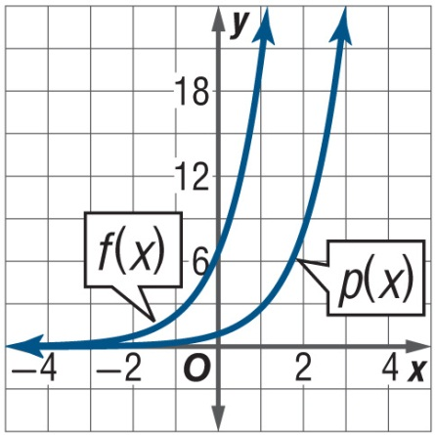
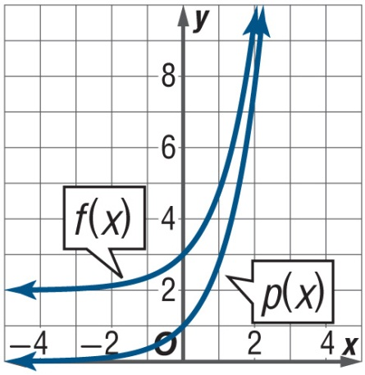
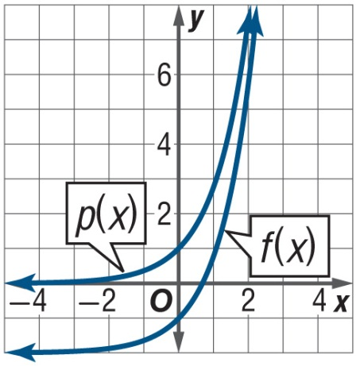
Example 3
B. Sketch the graph of the function p (x) = e^{x} + 2.
A.
B.
C.
D.

Slide 25
Key Concept 3

Slide 26
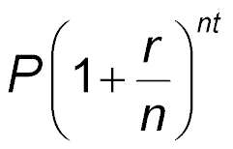
Example 4
Use Compound Interest
A. FINANCIAL LITERACY Mrs. Salisman invested $2000 into an educational account for her daughter when she was an infant. The account has a 5% interest rate. If Mrs. Salisman does not make any other deposits or withdrawals, what will the account balance be after 18 years if the interest is compounded quarterly?
For quarterly compounding, n = 4.
A =
Compound Interest Formula
=
P = 2000, r = 0.05, n = 365, t = 18

Slide 27
Example 4
Use Compound Interest
≈ 4891.84
Simplify.
With quarterly compounding, Mrs. Salisman’s daughter’s account balance after 18 years will be $4891.84.
Answer: $4891.84

Slide 28
Example 4
Use Compound Interest
B. FINANCIAL LITERACY Mrs. Salisman invested $2000 into an educational account for her daughter when she was an infant. The account has a 5% interest rate. If Mrs. Salisman does not make any other deposits or withdrawals, what will the account balance be after 18 years if the interest is compounded monthly?
For monthly compounding, n = 12, since there are 12 months in a year.

Slide 29
Example 4
Use Compound Interest
A =
Compound Interest Formula
=
P = 2000, r = 0.05, n = 12, t = 18
≈ 4910.02
Simplify.
With monthly compounding, Mrs. Salisman’s daughter’s account balance after 18 years will be $4910.02.
Answer: $4910.02

Slide 30
Example 4
Use Compound Interest
C. FINANCIAL LITERACY Mrs. Salisman invested $2000 into an educational account for her daughter when she was an infant. The account has a 5% interest rate. If Mrs. Salisman does not make any other deposits or withdrawals, what will the account balance be after 18 years if the interest is compounded daily?
For daily compounding, n = 365.

Slide 31
Example 4
Use Compound Interest
A =
Compound Interest Formula
=
P = 2000, r = 0.05, n = 12, t = 18
≈ 4910.02
Simplify.
With daily compounding, Mrs. Salisman’s daughter’s account balance after 18 years will be $4918.90.
Answer: $4918.90

Slide 32
Example 4
FINANCIAL LITERACY Mr. Born invested $5000 into a savings account at his local bank. The account has a 3% interest rate. If Mr. Born does not make any other deposits or withdrawals, what will the account balance be after 11 years if the interest is compounded monthly?
A. $6954.75
B. $6951.98
C. $6921.17
D. $6946.28

Slide 33
Key Concept 4

Slide 34
Example 5
Use Continuous Compound Interest
FINANCIAL LITERACY Mrs. Salisman found an account that will pay the 5% interest compounded continuously on her $2000 educational investment. What will be her account balance after 18 years?
A = Pe^{rt}
Compound Interest Formula
= 2000e^{(0.05)(18)}
P = 2000, r = 0.05,t = 18
≈ 4919.21
Simplify.

Slide 35
Example 5
Use Continuous Compound Interest
With continuous compounding, Mrs. Salisman’s account balance after 18 years will be $4919.21.
Answer: $4919.21

Slide 36
Example 5
ONLINE BANKING If $1500 is invested in a online savings account earning 4% per year compounded continuously, how much will be in the account at the end of 8 years if there are no other deposits or withdrawals?
A. $1548.78
B. $3133.94
C. $2065.69
D. $36,798.80

Slide 37
Key Concept 5

Slide 38
Example 6
Model Using Exponential Growth or Decay
A. POPULATION A state’s population is declining at a rate of 2.6% annually. The state currently has a population of approximately 11 million people. If the population continues to decline at this rate, predict the population of the state in 15 and 30 years.
Use the exponential decay formula to write an equation that models this situation.
A = N₀(1 + r)^{t}
Exponential Decay Formula
= 11,000,000(1 – 0.026)^{t}
N₀= 11,000,000 and r = –0.026

Slide 39
Example 6
Model Using Exponential Growth or Decay
= 11,000,000(0.974)^{t}
Simplify.
Use this equation to find N when t = 15 and t = 30.
t = 15
N = 11,000,000(0.974)^{t}
Modeling equation
= 11,000,000(0.974)¹⁵
t = 15
≈ 7,409,298
t = 30
N = 11,000,000(0.974)^{t}
Modeling equation
= 11,000,000(0.974)³⁰
t = 30
≈ 4,990,699

Slide 40
Example 6
Model Using Exponential Growth or Decay
Answer: If the state’s population continues to decline at an annual rate of 2.6%, its population in 15 years will be about 7,409,298; and in 30 years, it will be about 4,990,699.

Slide 41
Example 6
Model Using Exponential Growth or Decay
B. POPULATION A state’s population is declining at a rate of 2.6% continuously. The state currently has a population of approximately 11 million people. If the population continues to decline at this rate, predict the population of the state in 15 and 30 years.
Use the continuous exponential decay formula to write modeling equation.
N =N₀e^{kt} Continuous Exponential Decay Formula
=11,000,000e^{–0.026t} N₀ = 11,000,000 and k = –0.026

Slide 42
Example 6
Model Using Exponential Growth or Decay
Use this equation to find N when t = 15 and t = 30.
t = 15
N = 11,000,000e^{–0.026t} Modeling Equation
= 11,000,000e^{–0.026(15)}
≈ 7,447,626
t = 30
N = 11,000,000e^{–0.026t} Modeling Equation
= 11,000,000e^{–0.026(30)}
≈ 5,042,466

Slide 43
Example 6
Model Using Exponential Growth or Decay
Answer: If the state’s population continues to decline at a continuous rate of 2.6%, its population in 15 years will be about 7,447,626; and in 30 years it will be about 5,042,466.

Slide 44
Example 6
A. POPULATION The population of a town is increasing at a rate of 2% annually. If the current population is 15,260 people, predict the population in 10 and 20 years.
A. about 18,602 people in 10 years and 22,676 people in 20 years
B. about 18,639 people in 10 years and 22,765 people in 20 years
C. about 12,469 people in 10 years and 10,188 people in 20 years
D. about 12,494 people in 10 years and 10,229 people in 20 years

Slide 45
Example 6
B. POPULATION The population of a town is increasing at a rate of 2% continuously. If the current population is 15,260 people, predict the population in 10 and 20 years.
A. about 18,639 people in 10 years and 22,765 people in 20 years
B. about 18,602 people in 10 years and 22,676 people in 20 years
C. about 12,494 people in 10 years and 10,229 people in 20 years
D. about 12,469 people in 10 years and 10,188 people in 20 years

Slide 46
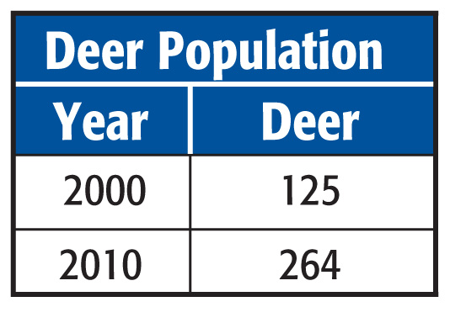
Example 7
Use the Graph of an Exponential Model
A. DEER The table shows the population growth of deer in a forest from 2000 to 2010. If the number of deer is increasing at an exponential rate, identify the rate of increase and write an exponential equation to model this situation.

Slide 47
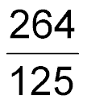
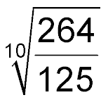
Example 7
Use the Graph of an Exponential Model
If we let N (t) represent the deer population t years after 2000 and assume exponential growth, then the initial deer population N₀ = 125 and at a time t = 2010 – 2000 or 10, the deer population N(10) = 264. Use this information to find the rate of growth r.
N(t) = N₀(1 + r)^{t} Exponential Growth Formula
264 = 125(1 + r)¹⁰ N(10) = 264, N₀ = 125, and t = 10
= (1 + r)¹⁰ Divide each side by 125.
= 1 + r Take the positive 10th root of each side.

Slide 48
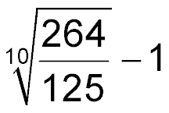
Example 7
Use the Graph of an Exponential Model
= r Subtract 1 from each side.
0.078 ≈ r Simplify
Answer: r ≈ 7.8%; N (t) = 125(1.078)^{t}

Slide 49
Example 7
Use the Graph of an Exponential Model
B. DEER The table shows the population growth of deer in a forest from 2000 to 2010. Use your model to predict how many years it will take for the number of deer to reach 500.

Slide 50
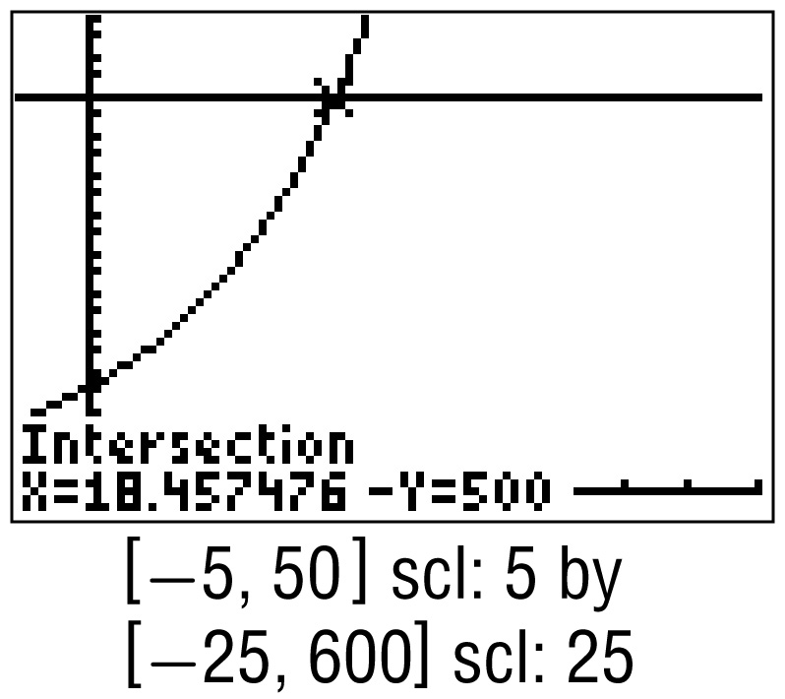
Example 7
Use the Graph of an Exponential Model
To find when the deer population will reach 500, find the intersection of the graph of N (t) = 125(1.078)^{t} and the line N (t) = 500. A graphing calculator shows that the value of t for which 125(1.078)^{t} = 500 is about 18.5.

Slide 51
Example 7
Use the Graph of an Exponential Model
Since t is the number of years after 2000, this model suggests that after the year 2000 + 18 or 2018, the deer population will be 500 if this rate of growth continues.
Answer: approximately 18 years

Slide 52
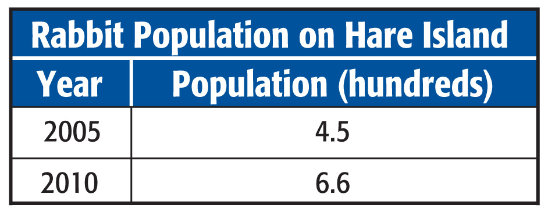
Example 7
A. RABBIT POPULATION Use the data in the table and assume that the population is growing exponentially. Identify the rate of growth and write an exponential equation to model this growth.
A. 8%; N(t) = 6.6(0.92)^{t}
B. 8%; N(t) = 4.5(0.92)^{t}
C. 8%; N(t) = 6.6(1.08)^{t}
D. 8%; N(t) = 4.5(1.08)^{t}

Slide 53
Example 7
B. RABBIT POPULATION Use the data in the table and assume that the population is growing exponentially. Use your model to predict in which year the rabbit population will surpass 850.
A. 2011
B. 2012
C. 2013
D. 2014

Slide 54
End of the Lesson

