Slide 1
Splash Screen

Slide 2
Then/Now
You solved right triangles using trigonometric functions. (Lesson 4-1)
Solve oblique triangles by using the Law of Sines.
Solve oblique triangles by using the Law of Cosines.
Find areas of oblique triangles using Heron’s Formula.

Slide 3
Vocabulary
oblique triangles
Law of Sines
ambiguous case
Law of Cosines
Heron’s Formula

Slide 4
Key Concept 1

Slide 5
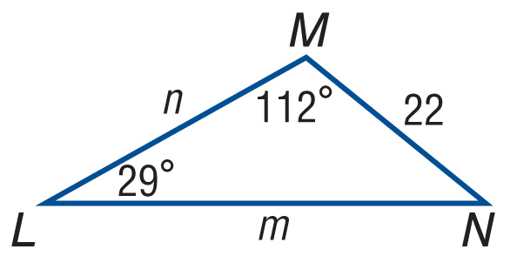
Example 1
Apply the Law of Sines (AAS)
Solve ΔLMN. Round side lengths to the nearest tenth and angle measures to the nearest degree.
Because two angles are given, N = 180º – (112º + 29º) or 39º.
Use the Law of Sines to find m and n.

Slide 6
Example 1
Apply the Law of Sines (AAS)
Law of Sines
Substitution
Multiply.
Divide.
Use a calculator.
Therefore, N = 39°, m ≈ 42.1, n ≈ 28.6
Answer: N = 39°, m ≈ 42.1, n ≈ 28.6

Slide 7
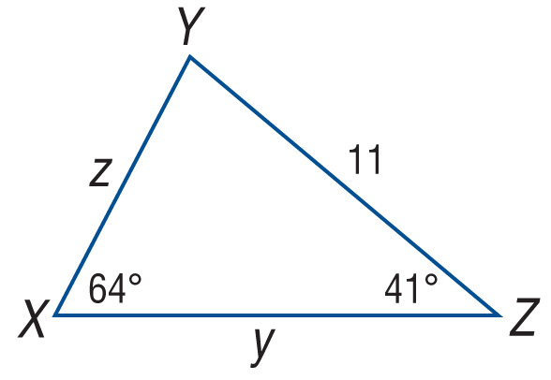
Example 1
Solve ΔXYZ. Round side lengths to the nearest tenth and angle measures to the nearest degree.
A. y ≈ 11.8, z ≈ 8.0, Y = 75°
B. y ≈ 8.0, z ≈ 5.3, Y = 85°
C. y ≈ 28.7, z ≈ 18.9, Y = 95°
D. y ≈ 14.6, z ≈ 9.9, Y = 75°

Slide 8
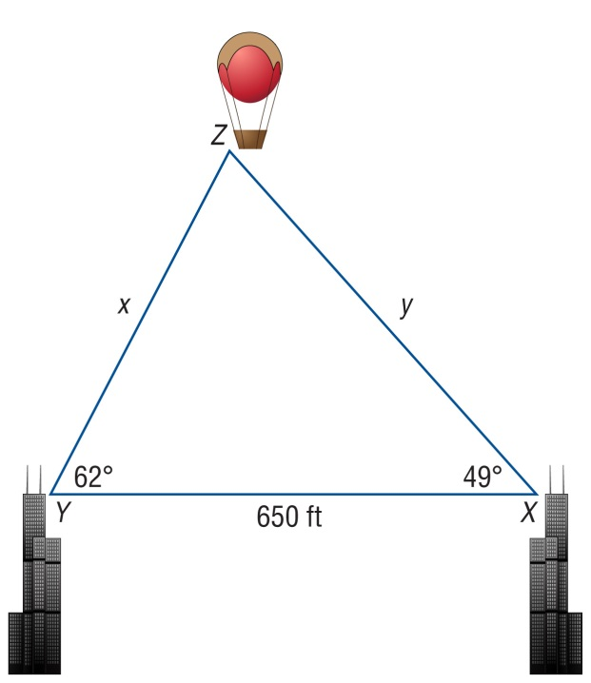
Example 2
Apply the Law of Sines (ASA)
BALLOONING The angle of elevation from the top of a building to a hot air balloon is 62º. The angle of elevation to the hot air balloon from the top of a second building that is 650 feet due east is 49º. Find the distance from the hot air balloon to each building.
Draw a figure showing the situation.

Slide 9
Example 2
Apply the Law of Sines (ASA)
Because two angles are given, Z = 180° – (62° + 49°) or 69°. Use the Law of Sines to find the distance to the balloon from each building.
Law of Sines
Substitution
Multiply.
Divide.

Slide 10
Example 2
Apply the Law of Sines (ASA)
x ≈ 525.5
Use a calculator.
y ≈ 614.7
So, the balloon is about 525.5 feet from the first building and 614.7 feet from the second building.
Answer: about 525.5 ft; 614.7 ft

Slide 11
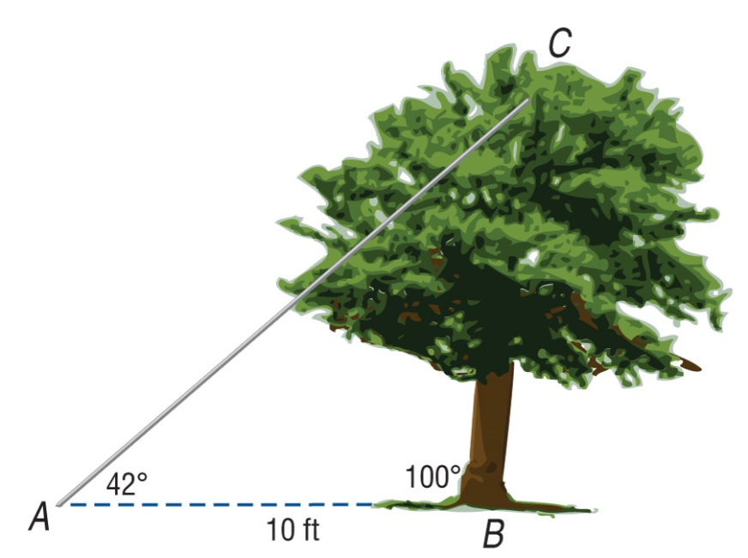
Example 2
TREE A tree is leaning 10° past vertical as shown in the figure. A wire that makes a 42° angle with the ground 10 feet from the base of the tree is attached to the top of the tree. How tall is the tree?
A. 6.8 ft
B. 7.8 ft
C. 14.3 ft
D. 10.9 ft

Slide 12
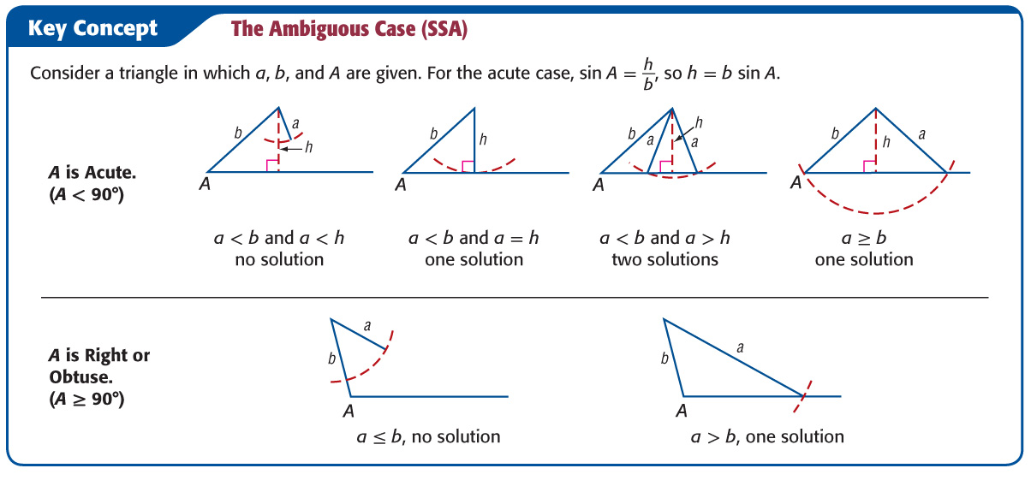
Key Concept 3

Slide 13
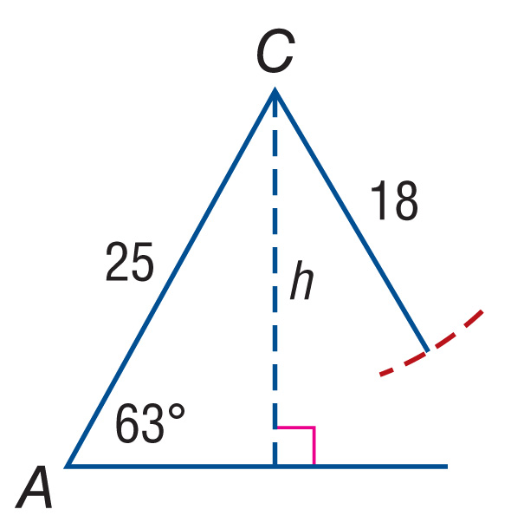
Example 3
The Ambiguous Case—One or No Solution
A. Find all solutions for the given triangle, if possible. If no solution exists, write no solution. Round side lengths to the nearest tenth and angle measures to the nearest degree. A = 63°, a = 18, b = 25
Notice that A is acute and a < b because 18 < 25. Find h.

Slide 14
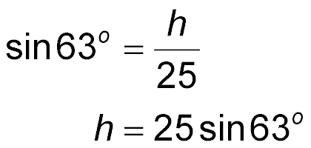
Example 3
The Ambiguous Case—One or No Solution
Definition of sine
h = b sin A
or about 22.3
Because a < h, no triangle can be formed with sides a = 18, b = 25, and A = 63°. Therefore, the problem has no solution.
Answer: no solution

Slide 15
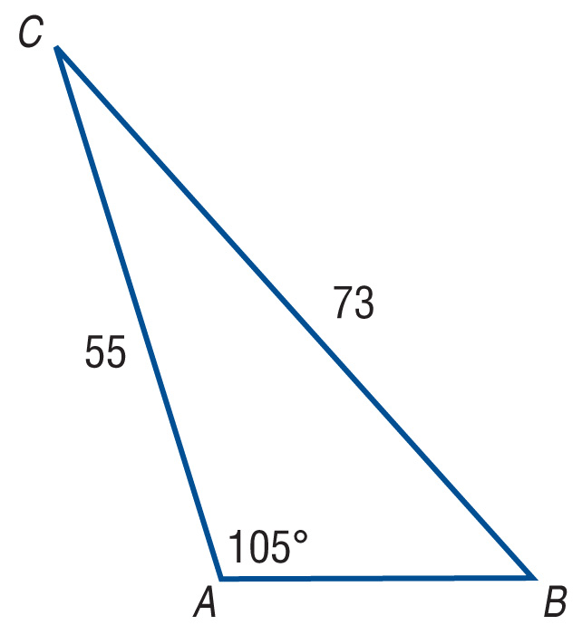
Example 3
The Ambiguous Case—One or No Solution
B. Find all solutions for the given triangle, if possible. If no solution exists, write no solution. Round side lengths to the nearest tenth and angle measures to the nearest degree. A = 105°, a = 73, b = 55
Notice that A is obtuse and a > b because 73 > 55. Therefore, one solution exists. Apply the Law of Sines to find B.

Slide 16
Example 3
The Ambiguous Case—One or No Solution
Law of Sines
Multiply each side by 55.
Definition of sin^{–1}
B ≈ 46.7°
Use a calculator.
Because two angles are now known, C ≈ 180° – (105° – 46.7°) or about 28.3°. Apply the Law of Sines to find c. Choose the ratios with the fewest calculated values to ensure greater accuracy.

Slide 17
Example 3
The Ambiguous Case—One or No Solution
Law of Sines
Solve for c.
Therefore, the remaining measures of ΔABC are B ≈ 47°, C ≈ 28°, c ≈ 35.8.
Answer: B ≈ 47°, C ≈ 28°, c ≈ 35.8

Slide 18
Example 3
Find all solutions for ΔABC where a = 18, b = 13, and A = 126º, if possible. If no solution exists, write no solution. Round side lengths to the nearest tenth and angle measures to the nearest degree.
A. B ≈ 42°, C ≈ 12°, c ≈ 4.6
B. B ≈ 28°, C ≈ 26°, c ≈ 9.8
C. B ≈ 36°, C ≈ 18°, c ≈ 6.9
D. no solution

Slide 19
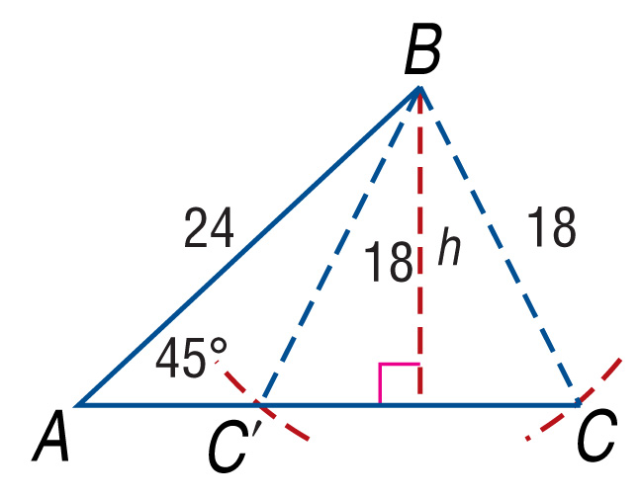
Example 4
The Ambiguous Case-Two Solutions
Find two triangles for which A = 45°, a = 18, and c = 24.Round side lengths to the nearest tenth and angle measures to the nearest degree.
A is acute, and h = 24 sin 45º or about 17.0. Notice that a < c because 18 < 24, and a > h because 18 > 17.0. Therefore, two different triangles are possible with the given angle and side measures. Angle C will be acute, while angle C' will be obtuse.

Slide 20
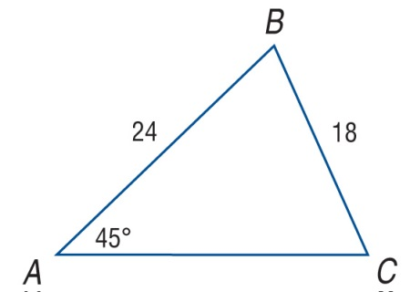
Example 4
The Ambiguous Case-Two Solutions
Make a reasonable sketch of each triangle and apply the Law of Sines to find each solution. Start with the case in which C is acute.
Solution 1 ∠C is acute.
Find C.
Law of Sines
Definition of sin^{–1}
Use a calculator.
Solve for sin C.

Slide 21
Example 4
The Ambiguous Case-Two Solutions
Find B.
B ≈ 180° – (70.48° + 45°) or about 64.52°
Apply the Law of Sines to find b.
Law of Sines

Slide 22
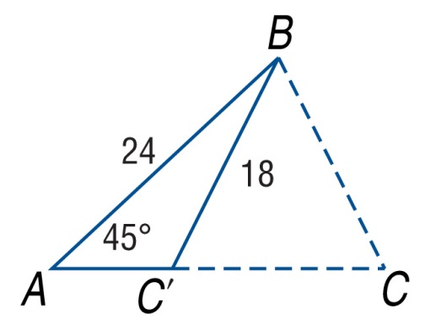
Example 4
The Ambiguous Case-Two Solutions
Solution 2 ∠C' is obtuse.
Note that m∠BC'C m∠BCC'. To find C', you need to find an obtuse angle with a sine that is also 0.9425. To do this, subtract the measure given by your calculator to the nearest degree, 70.48º, from 180º. Therefore, C' is approximately 180º – 70.48º or 109.52º.
Find B.
B ≈ 180° – (109.52° + 45° ) or 25.48

Slide 23
Example 4
The Ambiguous Case-Two Solutions
Apply the Law of Sines to find b.
Law of Sines
Solve for b.
Therefore, the missing measures for acute ΔABC are B ≈ 65°, C ≈ 70°, and b ≈ 23.0, while the missing measures for obtuse ΔABC' are B ≈ 25°, C ≈ 110°, and b ≈ 11.0
Answer: B ≈ 65°, C ≈ 70°, b ≈ 23.0; B ≈ 25°, C ≈ 110°, b ≈ 11.0

Slide 24
Example 4
Find two triangles for which A = 24°, a = 13, and b = 15. Round side lengths to the nearest tenth and angle measures to the nearest degree.
A. B ≈ 128°, C ≈ 28°, c ≈ 15.0, B ≈ 4°, C ≈ 152°, c ≈ 17.3
B. B ≈ 28°, C ≈ 128°, c ≈ 25.2, B ≈ 152°, C ≈ 4°, c ≈ 2.2
C. B ≈ 28°, C ≈ 128°, c ≈ 25.2, B ≈ 62°, C ≈ 92°, c ≈ 31.9
D. B ≈ 21°, C ≈ 135°, c ≈ 22.6, B ≈ 69°, C ≈ 87°, c ≈ 31.9

Slide 25
Key Concept 5

Slide 26
Example 5
Apply the Law of Cosines (SSS)
LANDSCAPING A triangular area of lawn has a sprinkler located at each vertex. If the sides of the lawn are a = 19 feet, b = 24.3 feet, and c = 21.8 feet, what angle of sweep should each sprinkler be set to cover?
Since three side lengths are given, you can use the Law of Cosines to find the largest angle, B.
b² = a² + c² – 2ac cos B Law of Cosines
24.3² = 19² + 21.8² – 2(19)(21.8)cos B a = 19, b = 24.3, and c = 21.8

Slide 27
Example 5
Apply the Law of Cosines (SSS)
590.49 = 361 + 475.24 – 828.4 cos B Simplify.
590.49 = 836.24 – 828.4 cos B Add.
–245.75 = –828.4 cos B Subtract 836.24 from each side.
Divide each side by –828.4.
Use the cos^{–1} function.

Slide 28
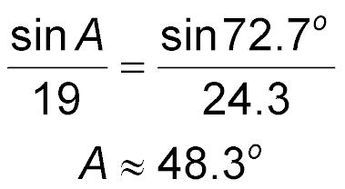
Example 5
Apply the Law of Cosines (SSS)
Use a calculator.
Use the Law of Sines to find A.
Law of Sines
Solve for A.
Then, find C.
C ≈ 180° – (72.7° + 48.3°)
C ≈ 59.0°

Slide 29
Example 5
Apply the Law of Cosines (SSS)
The angle of sweep for A is about 48°, the angle of sweep for B is about 73°, and the angle of sweep for C is about 59°.
Answer: A ≈ 48°, B ≈ 73°, C ≈ 59°.

Slide 30
Example 5
LOT A triangular lot has sides of 120 feet, 186 feet, and 147 feet. Find the angle across from the shortest side.
A. 9°
B. 40°
C. 49°
D. 52°

Slide 31
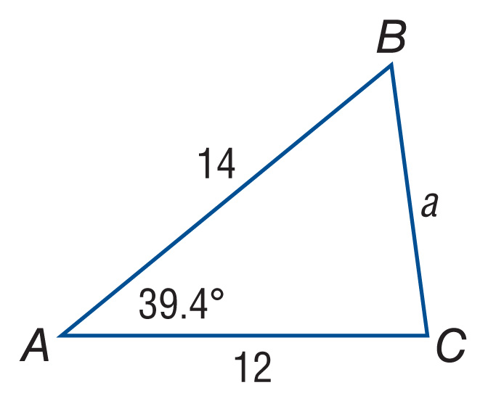
Example 6
Apply the Law of Cosines (SAS)
Solve ΔABC. Round side lengths to the nearest tenth and angle measures to the nearest degree.

Slide 32
Example 6
Apply the Law of Cosines (SAS)
Step 1 Use the Law of Cosines to find the missing side measure.
a² = b² + c² – 2bc cos A Law of Cosines
a² = 12² + 14² – 2(12)(14)cos 39.4º b = 12, c = 14, and A = 39.4º
a² ≈ 80.36 Use a calculator.
a ≈ 9.0 Take the positive square root of each side.

Slide 33
Example 6
Apply the Law of Cosines (SAS)
Step 2 Use the Law of Sines to find a missing angle measure.
Multiply each side by 12.
B ≈ 57.8°
Definition of sin^{–1}

Slide 34
Example 6
Apply the Law of Cosines (SAS)
Step 3 Find the measure of the remaining angle.
C ≈ 180° – (39.4° + 57.8°) or 82.8°
Therefore, a ≈ 9.0, B ≈ 58°, and C ≈ 83°.
Answer: a ≈ 9.0, B ≈ 58°, C ≈ 83°

Slide 35
Example 6
Solve ΔMNP if M = 54º, n = 17, and p = 12. Round side lengths to the nearest tenth and angle measures to the nearest degree.
A. m ≈ 193.2, N ≈ 4°, P ≈ 122°
B. m ≈ 13.9, N ≈ 82°, P ≈ 44°
C. m ≈ 17.7, N ≈ 51°, P ≈ 75°
D. m ≈ 16.1, N ≈ 59°, P ≈ 67°

Slide 36
Key Concept 7

Slide 37
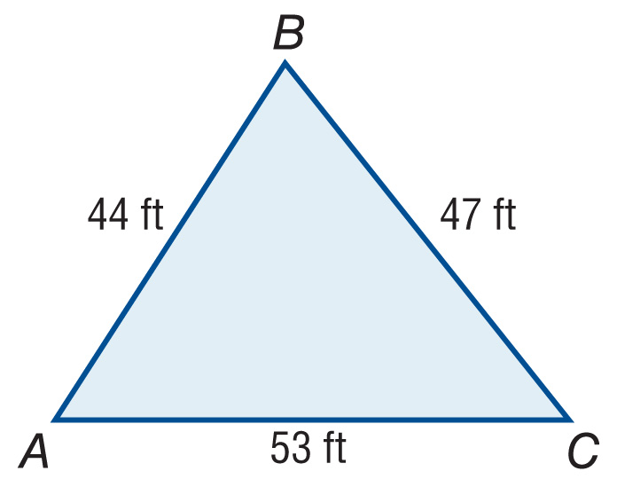
Example 7
Heron’s Formula
Find the area of ΔABC to the nearest tenth.
.
Heron's Formula
s = 72, a = 47, b = 53, and c = 44

Slide 38
Example 7
Heron’s Formula
Simplify.
Use a calculator.
Answer: about 978.6 ft²

Slide 39
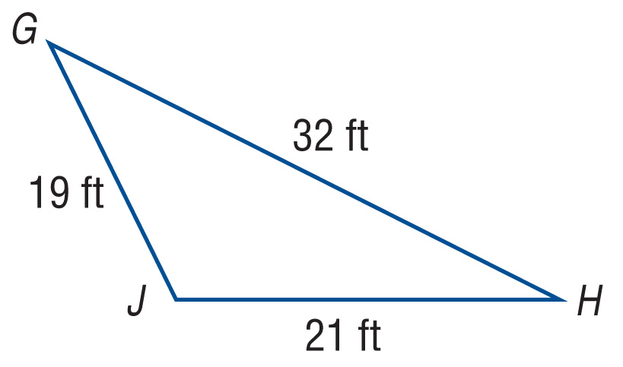
Example 7
Find the area of ΔGHJ.
A. 2790.1 ft²
B. 678.0 ft²
C. 191.6 ft²
D. 31.9 ft²

Slide 40
Key Concept 8

Slide 41
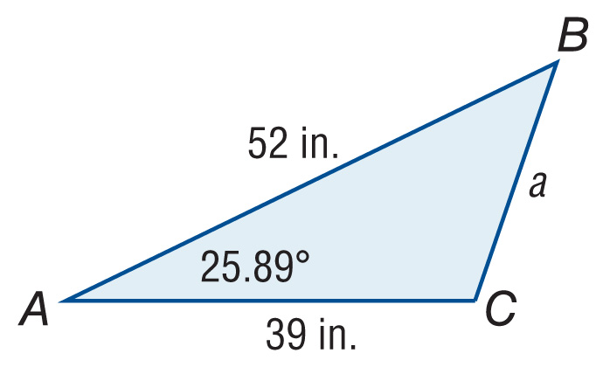
Example 8
Find the Area of a Triangle Given SAS
Find the area of ΔABC to the nearest tenth.
In ΔABC, b = 39, c = 52, and A = 25.89º.
Area of a triangle using SAS
Substitution.
Simplify.

Slide 42
Example 8
Find the Area of a Triangle Given SAS
So, the area is about 442.8 in².
Answer: about 442.8 in²

Slide 43
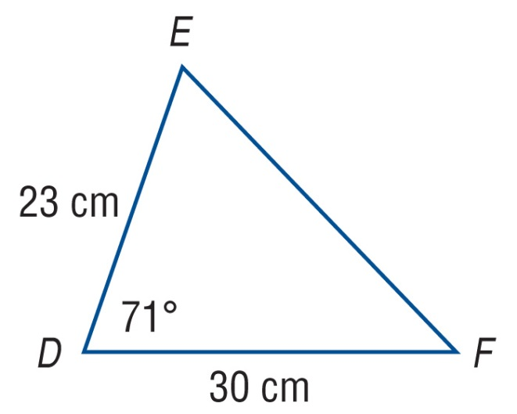
Example 8
Find the area of ΔDEF to the nearest tenth.
A. 652.4 cm²
B. 326.2 cm²
C. 224.6 cm²
D. 112.3 cm²

Slide 44
End of the Lesson

